Slide 1
NHLBI
Deep Learning Crash Course
Hui Xue
hui.xue@nih.gov
National Heart, Lung, and Blood Institute
Fall 2021

Slide 2
Outline
CNN architectures
Object detection : YOLO
Segmentation : U-net
Denoising and super-resolution
Network compression

Slide 3
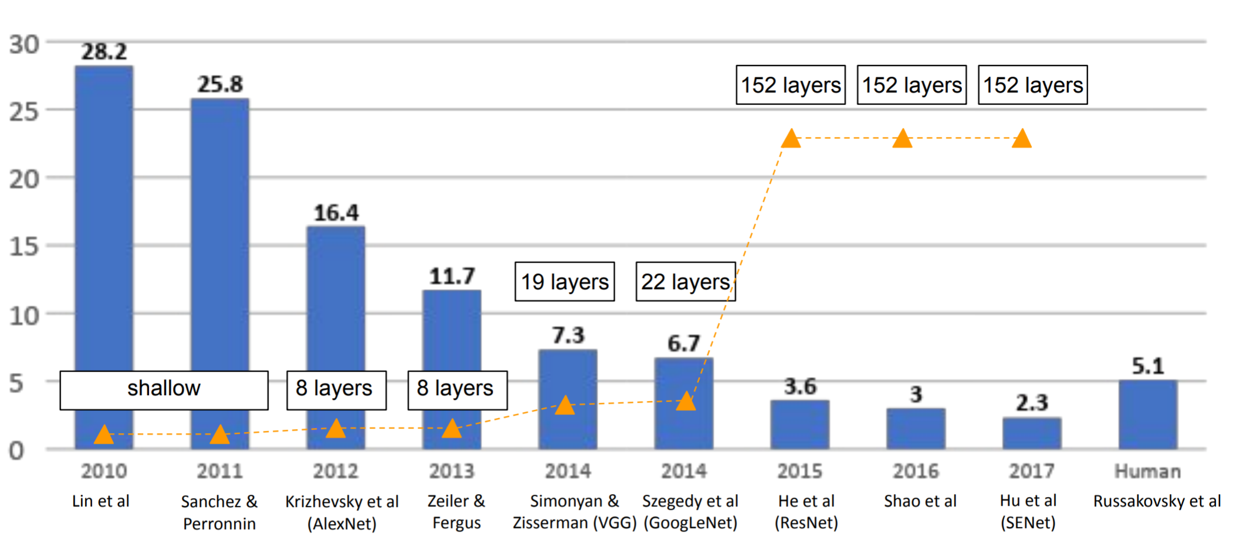
ImageNet winners
~61M parameters
Backprop to train CONV
Use ave max pooling
Use tanh ReLU
Use flatten and FC
Use softmax and CE loss
Increase number of filters with reduced spatial resolution
Much bigger
Data augmentation
Use GPU for training
Much larger dataset
CONV1
ReLU
Max Pool
CONV2
ReLU
Max Pool
CONV3
ReLU
CONV4
ReLU
CONV5
ReLU
Max Pool
Flatten
FC1
ReLU
FC2
ReLU
FC3
AlexNet
Logits
Bx1000
Bx3x227x227
… …

Slide 4
Z-F net, 2013
CONV1
ReLU
Max Pool
CONV2
ReLU
Max Pool
CONV3
ReLU
CONV4
ReLU
CONV5
ReLU
Max Pool
Flatten
FC1
ReLU
FC2
ReLU
FC3
ZF Net
Logits
Bx1000
Bx3x227x227
11x11, stride 4 → 7x7, stride 2
K=384 → K=512
By then, indicate the potential of CONV networks
Win the #1 place by hyperparameter searching
K=384 → K=1024
Top 5 accu: 16.4% → 11.7%
K=256 → K=512
Visualizing and Understanding Convolutional Networks. https://arxiv.org/abs/1311.2901

Slide 5
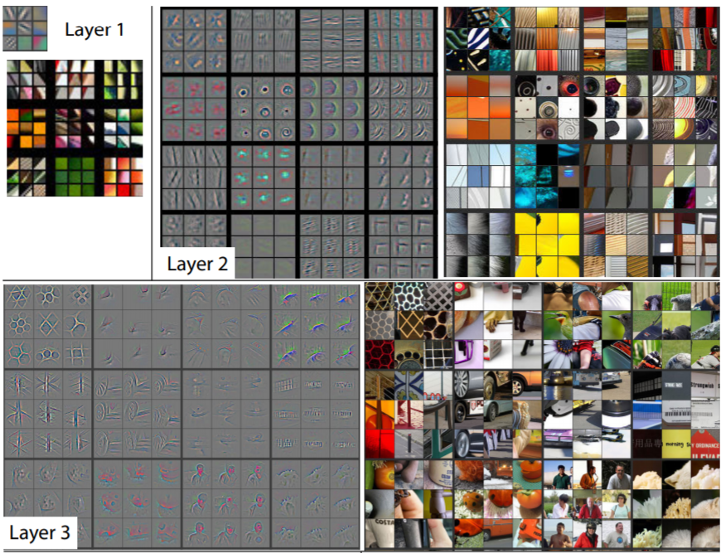
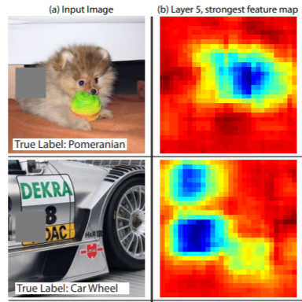
Z-F net paper has other contributions
A seminal paper for neural network visualization
Insights to understand convnet
More in the NN visualization later
Visualizing and Understanding Convolutional Networks. https://arxiv.org/abs/1311.2901

Slide 6
VGG net, 2014
CONV, 3x3, 64
CONV, 3x3, 64
Max Pool
CONV, 3x3, 128
CONV, 3x3, 128
Max Pool
CONV, 3x3, 256
CONV, 3x3, 256
CONV, 3x3, 256
Max Pool
CONV, 3x3, 512
CONV, 3x3, 512
CONV, 3x3, 512
Max Pool
CONV, 3x3, 512
CONV, 3x3, 512
CONV, 3x3, 512
Max Pool
FC1, D=4096
FC2, D=4096
FC3, D=1000
For Bx3x224x224 inputs
VGG16: ~138M parameters
FC1: ~74% of total #paras
VGG 16
Logits
CONV, 3x3, 64
CONV, 3x3, 64
Max Pool
CONV, 3x3, 128
CONV, 3x3, 128
Max Pool
CONV, 3x3, 256
CONV, 3x3, 256
CONV, 3x3, 256
CONV, 3x3, 256
Max Pool
CONV, 3x3, 512
CONV, 3x3, 512
CONV, 3x3, 512
CONV, 3x3, 512
Max Pool
CONV, 3x3, 512
CONV, 3x3, 512
CONV, 3x3, 512
CONV, 3x3, 512
Max Pool
FC1, D=4096
FC2, D=4096
FC3, D=1000
VGG 19
Logits
Go deeper!
Alexnet 8 layers with weights to 16 – 19 layers
Only use 3x3 conv kernel with stride 1 → do not change image size
Solely relying on max pooling to reduce image size
ReLU after every CONV
Top 5 accu: 11.7% → 7.3%
Very Deep Convolutional Networks for Large-Scale Image Recognition. https://arxiv.org/abs/1409.1556

Slide 7
VGG net, 2014
Stack small CONV layers to gain larger receptive fields
Reduced computation
Cleaner architecture design
Still has the expensive FC layer
CONV, 3x3, padding 1, stride 1
CONV, 3x3, padding 1, stride 1
CONV, 3x3, padding 1, stride 1
Very Deep Convolutional Networks for Large-Scale Image Recognition. https://arxiv.org/abs/1409.1556

Slide 8
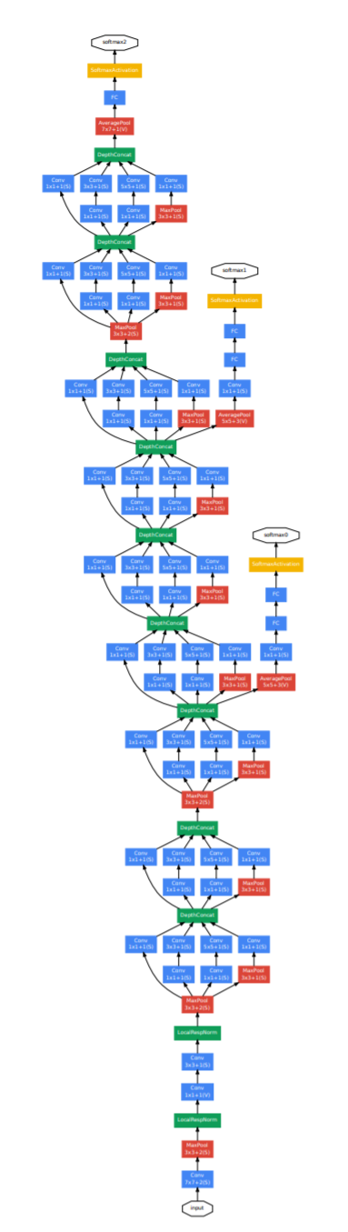
GoogLeNet, 2014
loss
Go deeper and go wider !
22 layers
Inception module
Extensively using 1x1 conv layer
Remove the expensive FC layer
Use intermediate feature maps for loss computation
Only ~5M parameters
Top 5 accu: 11.7% → 6.7%

Slide 9
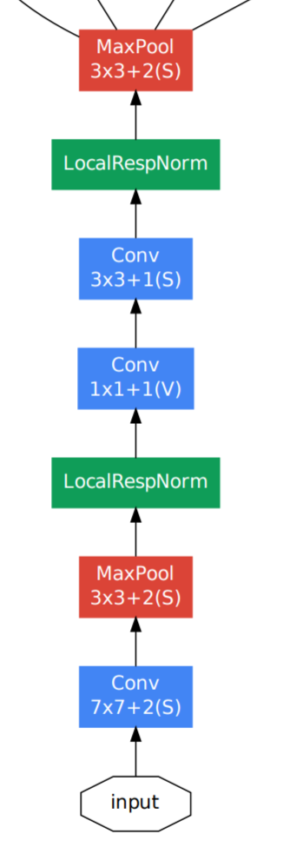
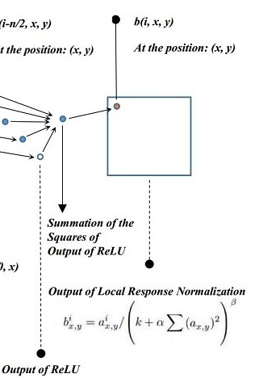
GoogLeNet, 2014
loss
Staring phase:
192x28x28
192x56x56
64x56x56
Local response normalization
64x112x112
3x224x224
https://www.quora.com/What-is-local-response-normalization

Slide 10
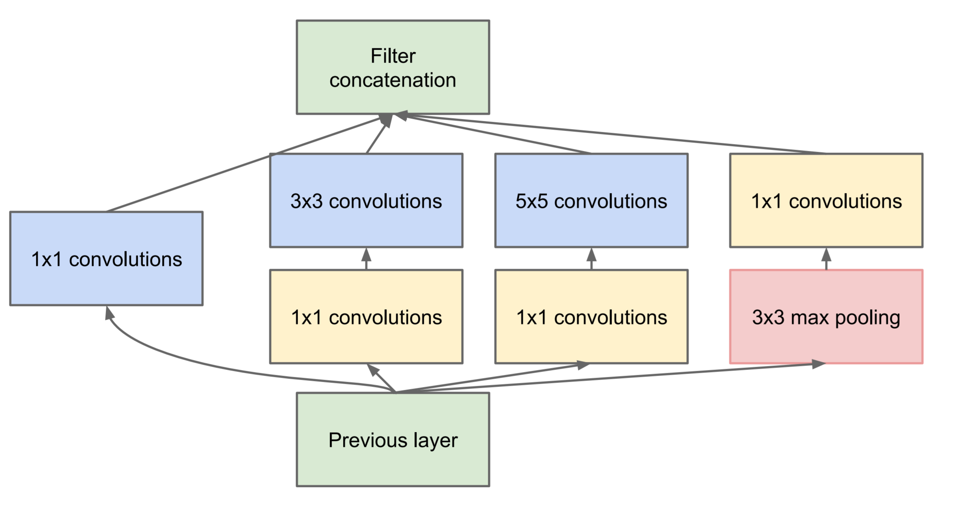
GoogLeNet, 2014
loss
Inception module:
(128+192+96+64) x28x28
Concatenate along channel
Instead of having a single pass, having multiple passes
Use 1x1 conv to reduce computation
Concatenate along channels
64x28x28
128x28x28
192x28x28
96x28x28
64x28x28
64x28x28
192x28x28
192x28x28

Slide 11
Google Inception net, 2014
loss
Stack several inception modules with different number of output channels
Instead of having a single pass, having multiple passes
Use 1x1 conv to reduce computation
Concatenate along channels
Concatenate along channel
64x28x28
128x28x28
192x28x28
96x28x28
64x28x28
64x28x28
192x28x28
192x28x28

Slide 12
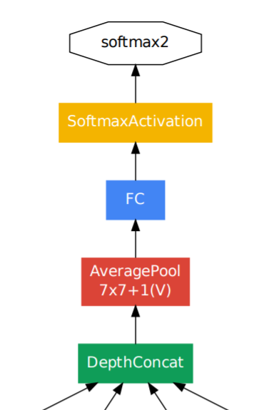
Google Inception net, 2014
loss
Output phase:
Averaging pooling for every 2D feature map, CxHxW → Cx1x1
Avoid the expensive FC layer
Avoid flatten layer

Slide 13
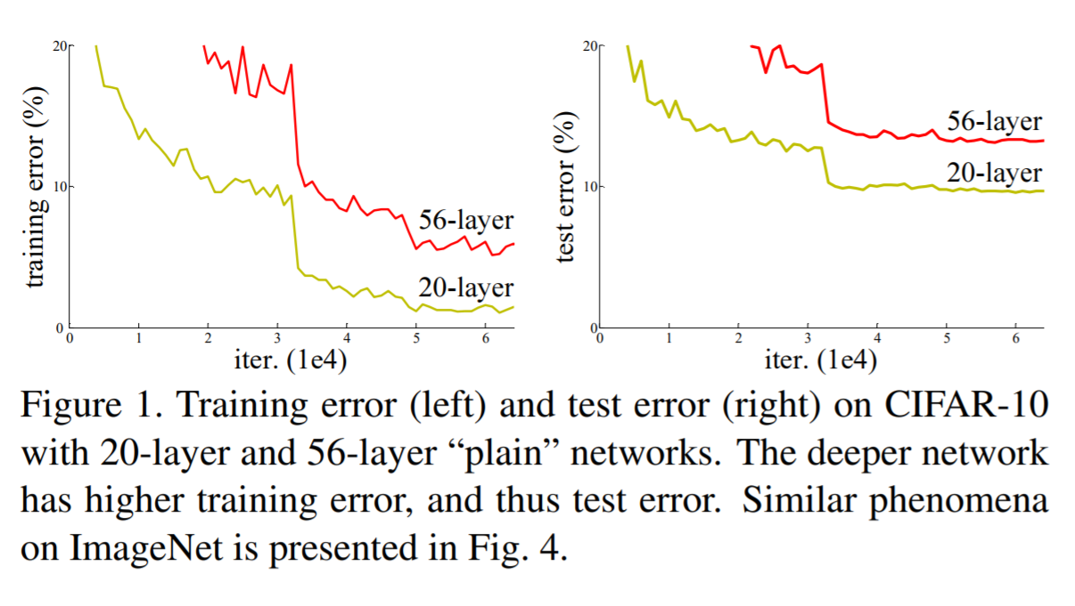
Resnet, 2015
“Going deeper” improves performance
But getting harder to train (mitigated by GoogLeNet, not an ideal solution)
Is this due to over-fitting?
Deep Residual Learning for Image Recognition. https://arxiv.org/abs/1512.03385

Slide 14
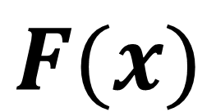
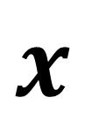
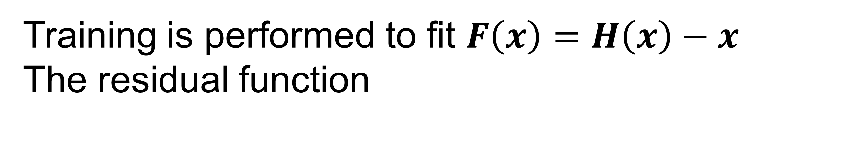
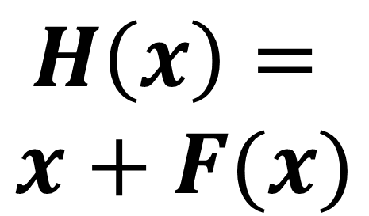
Resnet : residual connection
$$F(x)$$
CONV1
ReLU
CONV1
$$H\left(x\right)=$$
$$x+F(x)$$
ReLU
$$x$$
Residual connection
Allow gradient flow to pass through
Make training deeper network easier, if there are enough data
No extra parameters
Constraint on network design
Training is performed to fit $F\left(x\right)=H\left(x\right)−x$
The residual function

Slide 15
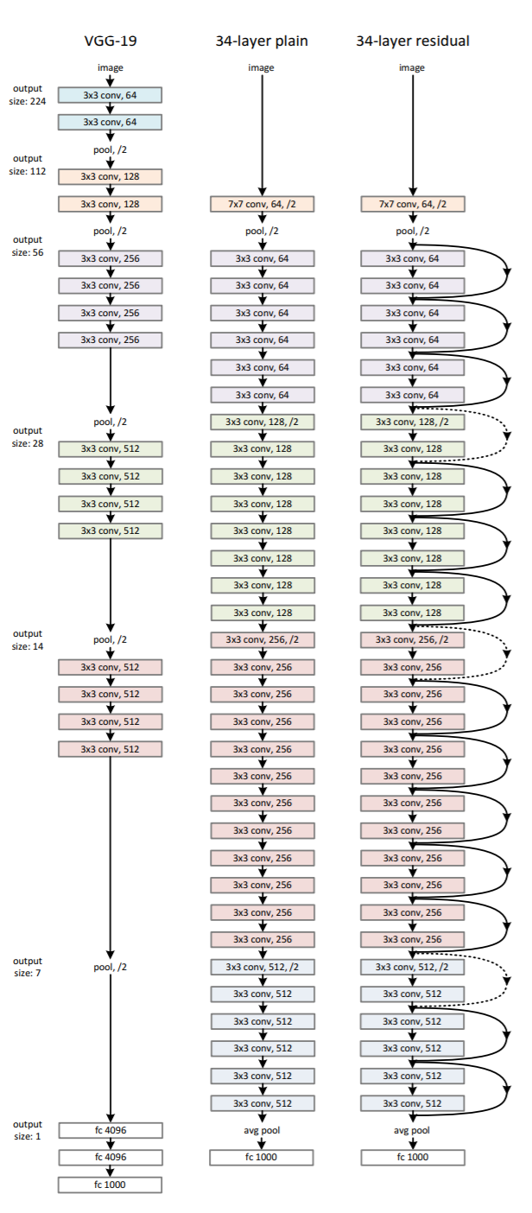
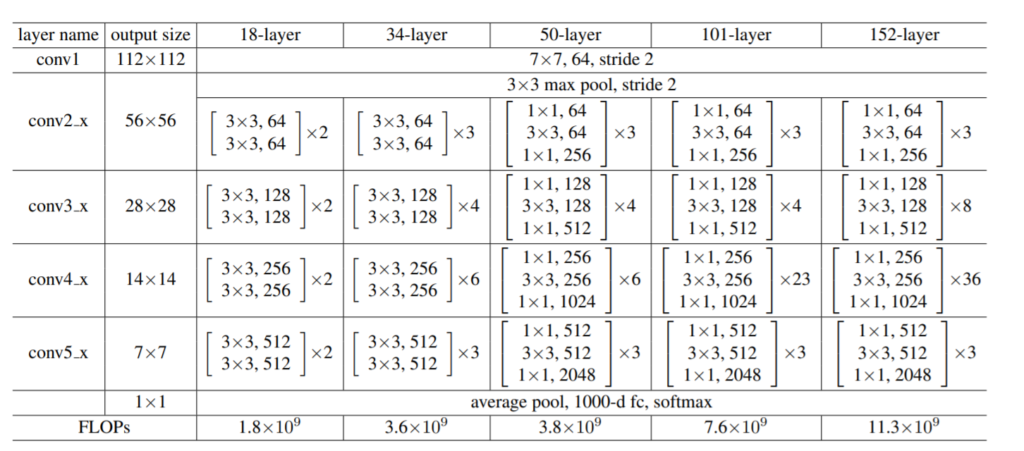
Resnet : residual connection
stride convolution
stride convolution
A lot of similarities to VGG
3x3 conv to keep image size
Use stride convolution to reduce image size
Increase number of channels while reducing image size
Much deeper – ResNet 34/50/101/152 layers
Avoid expensive FC – same as VGG
stride convolution

Slide 16
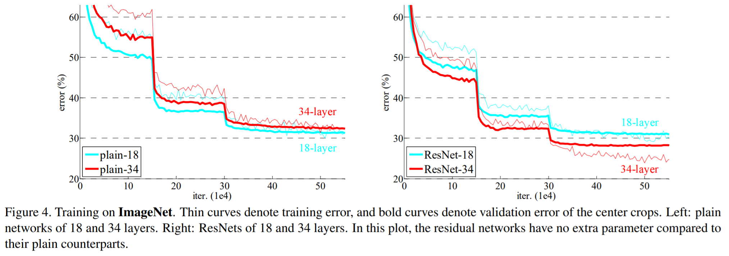
Resnet : residual connection
Top 5 accu: 6.7% → 3.6%
Better than human error (5.1%)
https://arxiv.org/abs/1409.0575

Slide 17
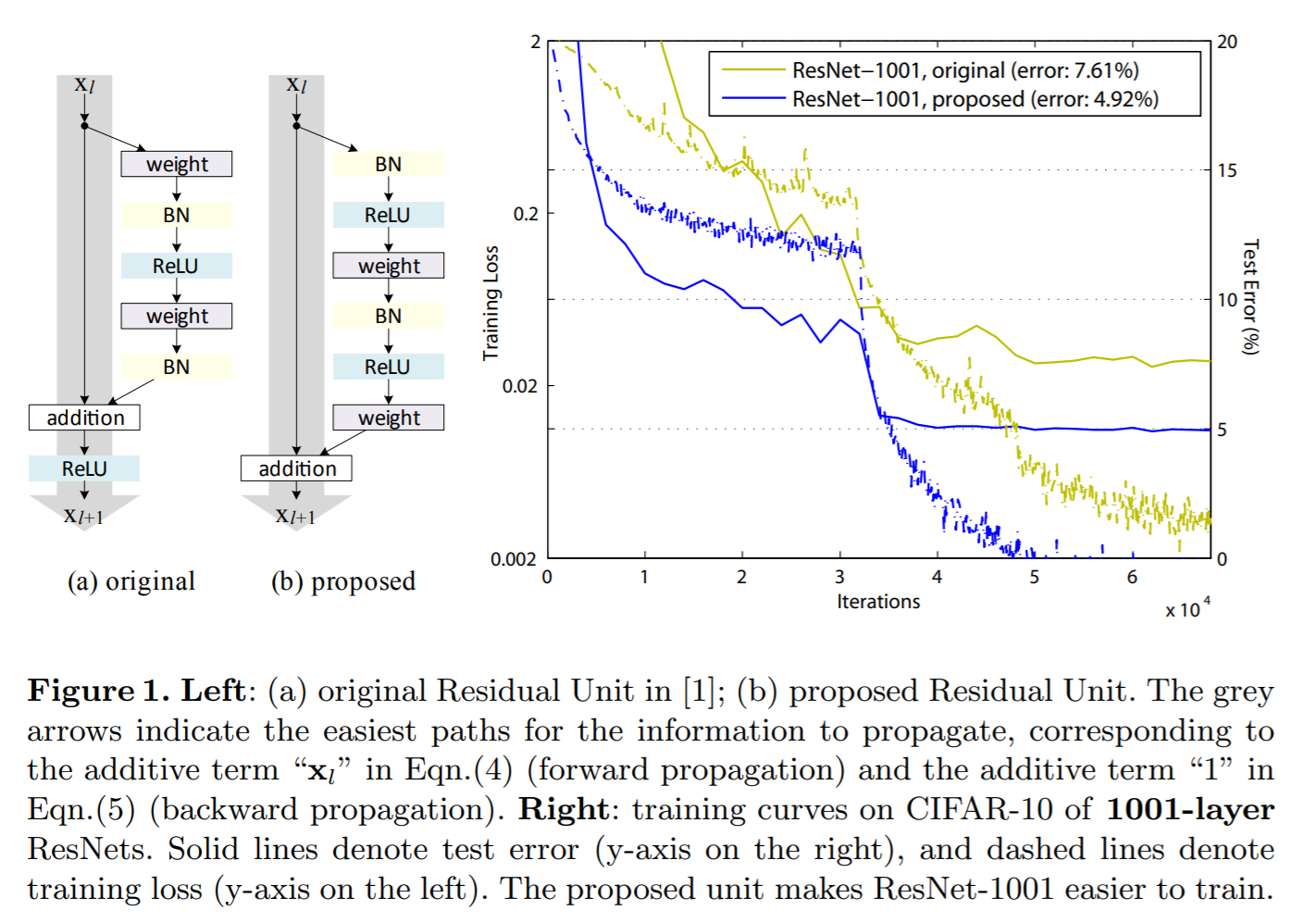
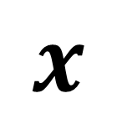
Resnet : with batch normalization
$$x$$
CONV
Use the (b) layout
Network needs input CONV layers

Slide 18
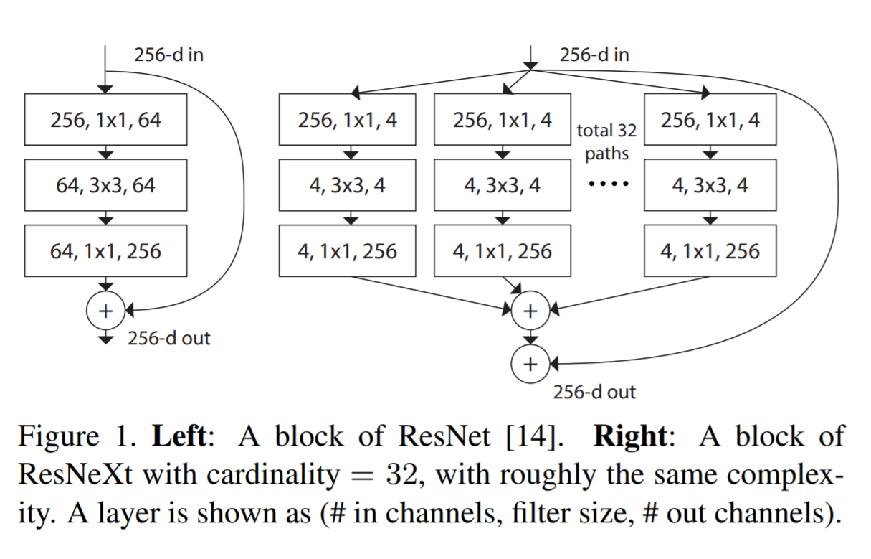
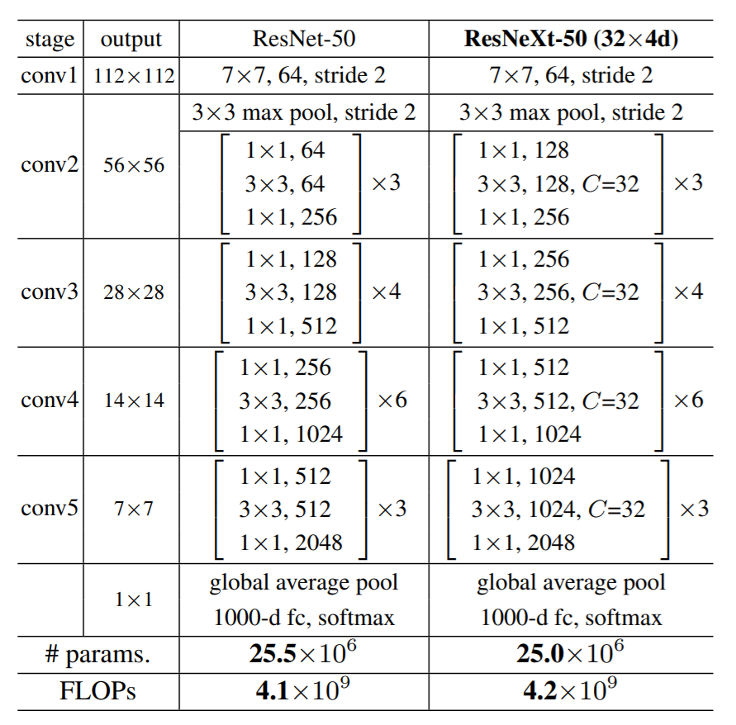
ResNeXt 2016 : wider network with skip connection
Combine the idea of inception module with residual connection
Use 1x1 conv to reduce computation
Multiple passes with homogenous architecture
Top 5 accu: 3.6% → 3.0%

Slide 19
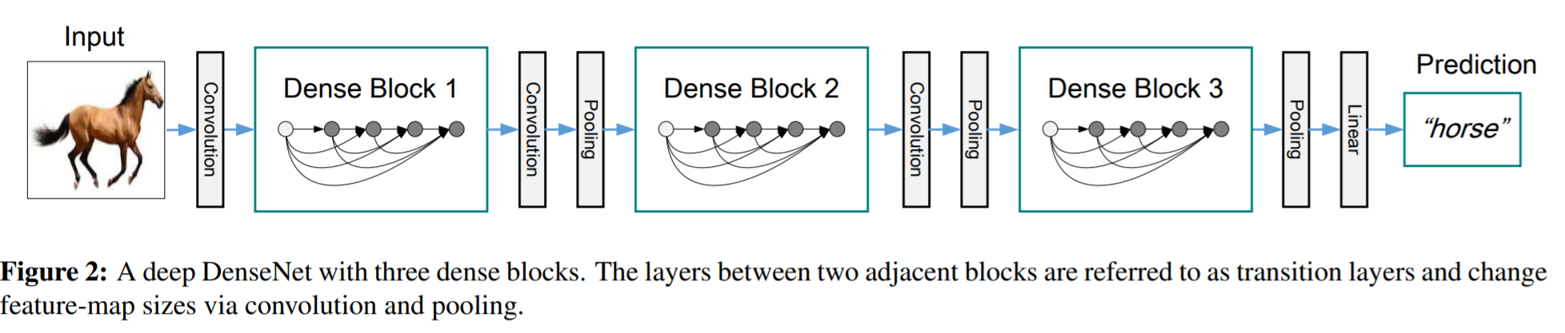
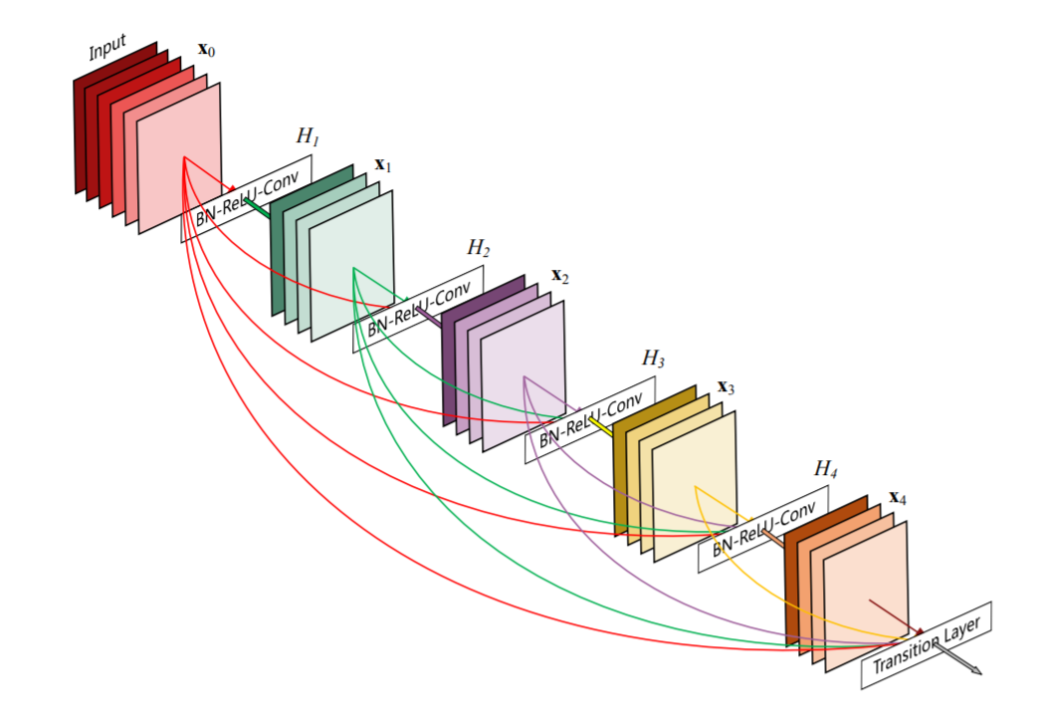
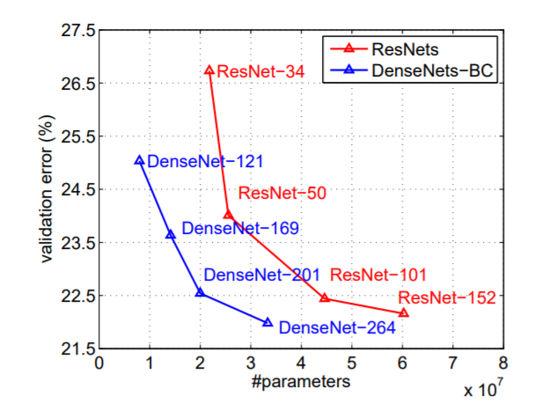
DenseNet : Densely Connected Convolutional Networks
Heavily using 3x3 and 1x1 conv
Flexible dense block design
Optionally, reduce number of feature maps by half between dense blocks (DenseNet-BC)
Densely Connected Convolutional Networks. https://arxiv.org/abs/1608.06993

Slide 20
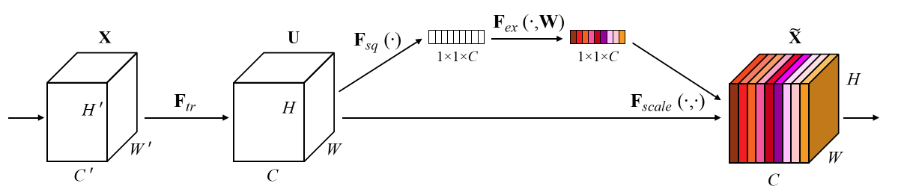
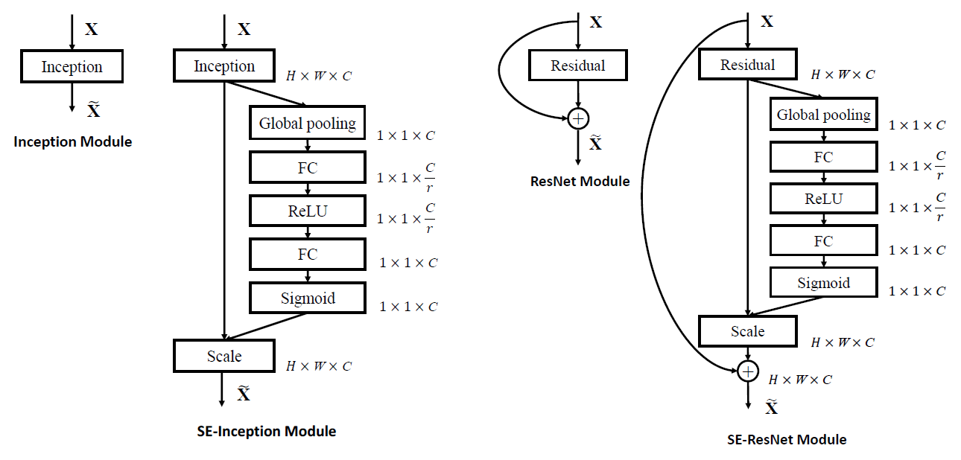
SENet 2017 : Squeeze-and-Excitation Network
A SE module to rebalance channels
First, global pooling along HxW
Then squeeze with a FC layer
Then expand it back to C channels
After sigmoid, use the C ratio to scale every channel
Relying on training to learn the best weights to rebalance channels
With SE module, every channel contributes to all other channels → similar idea is popular in attention mechanism
r can be 4, 8, 16, 32 …
Not sensitive to accuracy
Top 5 accu: 3.0% → 2.3%

Slide 21
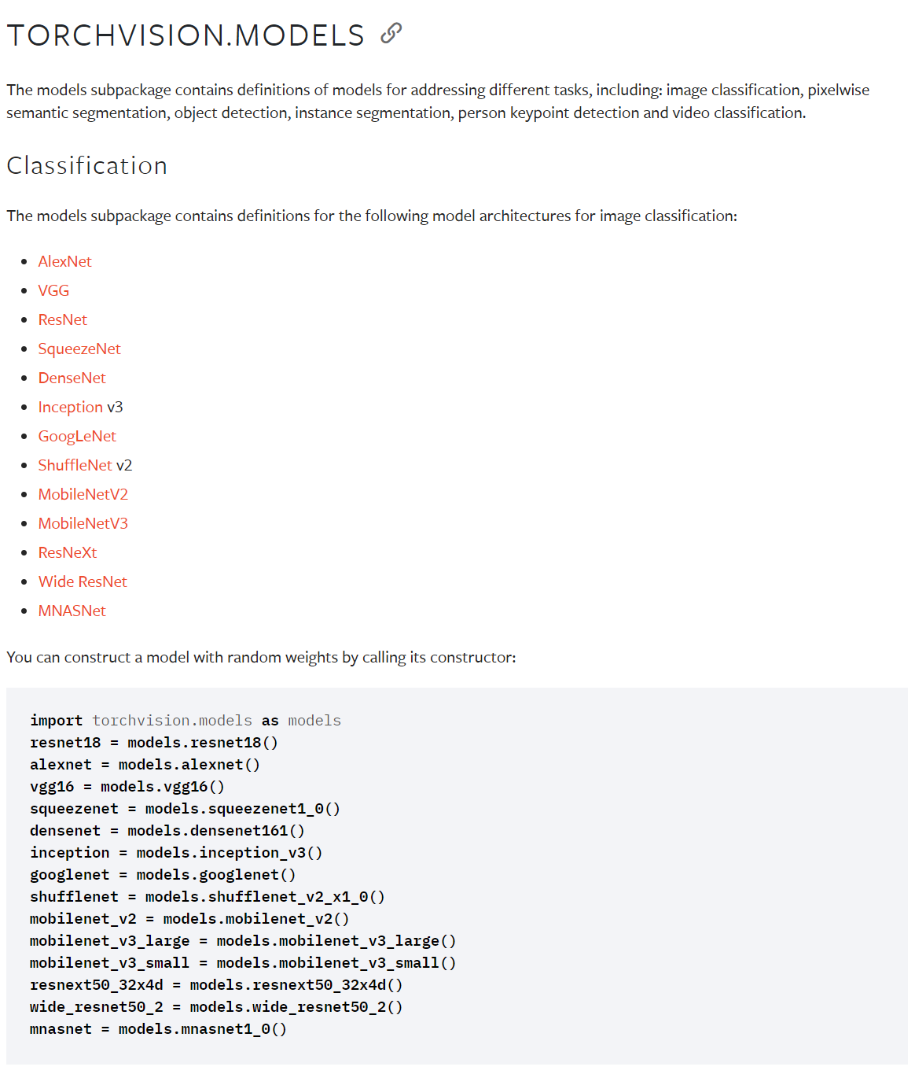
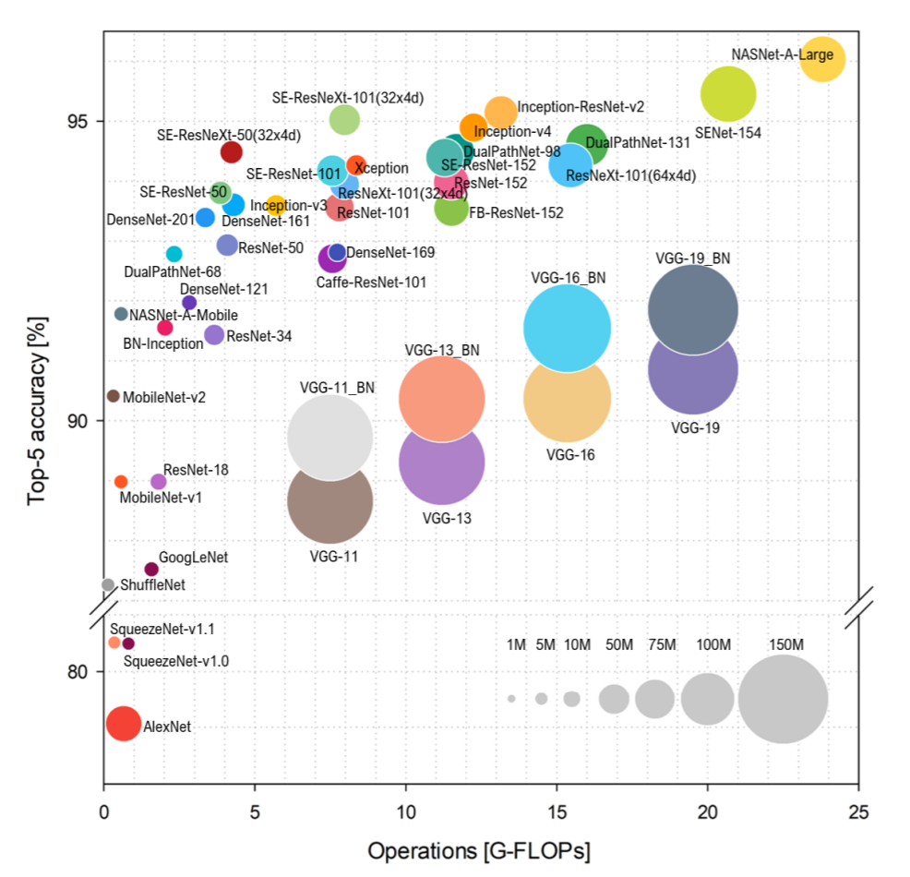
Many other models in Pytorch model zoo
Sweet spots
https://pytorch.org/vision/stable/models.html
Benchmark Analysis of Representative Deep Neural Network Architectures. https://arxiv.org/pdf/1810.00736.pdf
https://pytorch.org/serve/model_zoo.html

Slide 22
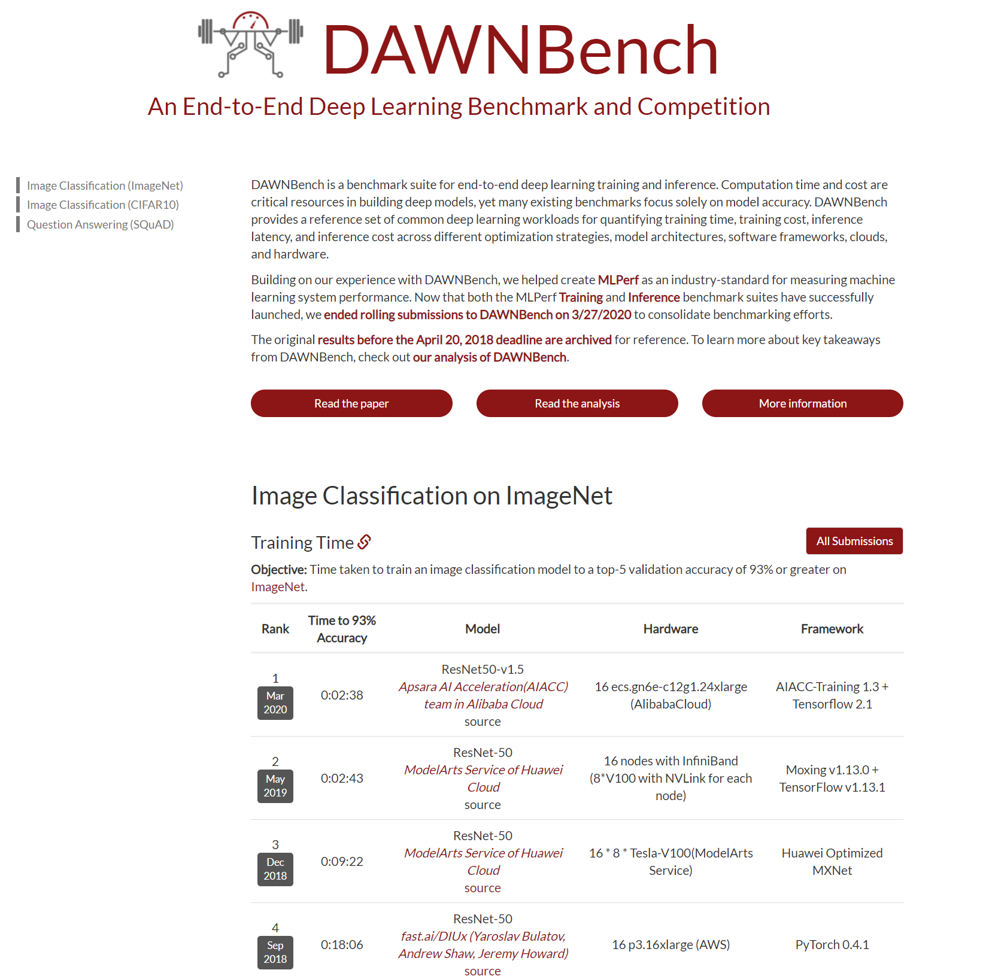
Another dimension: training speed
Sweet spots
Good balance with computation and accuracy
ResNet, ResNext, DenseNet type network with Batch normalization
Adam optimization, OneCycle scheduler
Training time
Training cost
Inference latency
Inference cost
https://dawn.cs.stanford.edu/benchmark/#imagenet-train-time

Slide 23
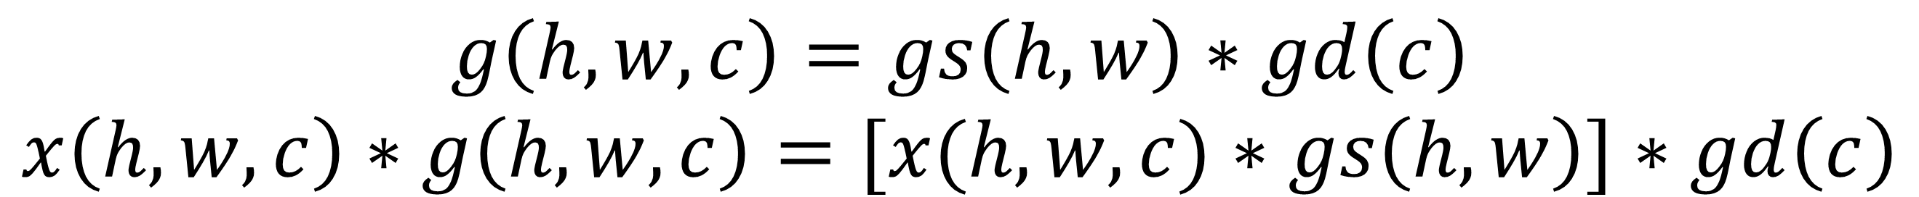
Mobile net : depth-wise separable convolution
Add the “soft constraint” to have depth separable convolution
CONV 3x3
9xKxCxHxW multiplications
CONV 3x3, depth-wise
9xCxHxW multiplications
CONV 1x1
KxCxHxW multiplications
9KC >> (9+K)C
$$g\left(h,w,c\right)=gs\left(h,w\right)∗gd\left(c\right)$$
$$x\left(h,w,c\right)∗g\left(h,w,c\right)=[x(h,w,c)∗gs\left(h,w\right)]∗gd\left(c\right)$$
CONV, 3x3
BN
ReLU
CONV, 3x3, along depth only
CONV, 1x1
BN
ReLU
BxCxHxW
BxKxHxW
BxCxHxW
BxKxHxW
3x3 conv, stride 1, padding 1, K channels
3x3 conv, stride 1, padding 1
BxCxHxW → BxCxHxW
1x1 conv, stride 1, padding 0
BxCxHxW → BxKxHxW
MobileNets: Efficient Convolutional Neural Networks for Mobile Vision Applications. https://arxiv.org/abs/1704.04861

Slide 24
Group convolution and depth-wise convolution
H’xW’, K output channels
HxW
3x3, K filters
Perform convolution for every output channel
CxHxW→ KxHxW, kenrel size k_{x}xk_{y}xCxK
… …
Normal convolution
… …
=
C
*
C
H’xW’, K output channels
HxW
3x3, K filters
Perform convolution for every group
Split along the input channel dimension
… …
Group convolution, G=2
C/2
*
… …
=
C
C/2
*
=

Slide 25
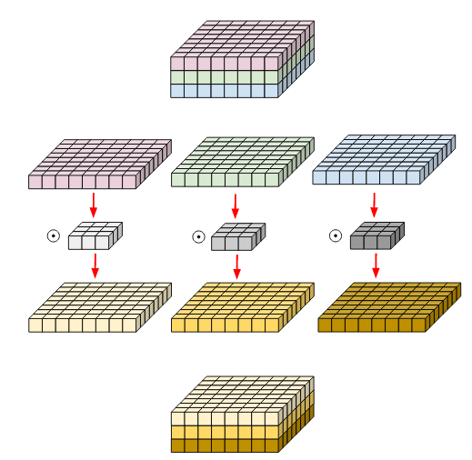
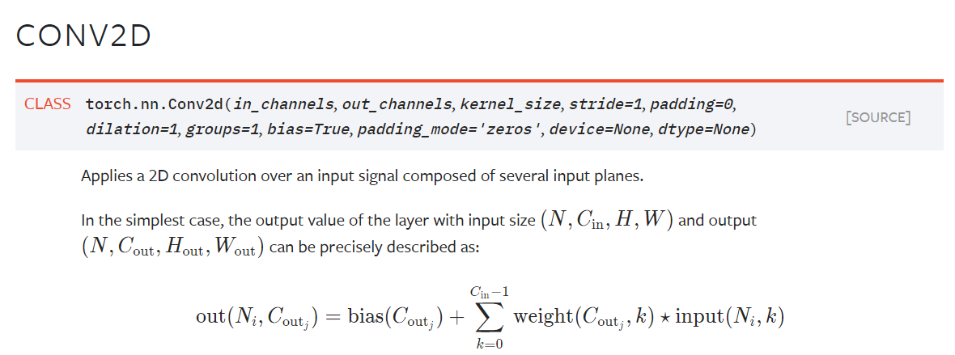
Deep-wise convolution
Depth-wise convolution is implemented with group convolution with G=C
So 2D convolution for every input channel independently
Split along input channel
convolve each channel separately
Put together along channel dimension
https://medium.com/@zurister/depth-wise-convolution-and-depth-wise-separable-convolution-37346565d4ec

Slide 26
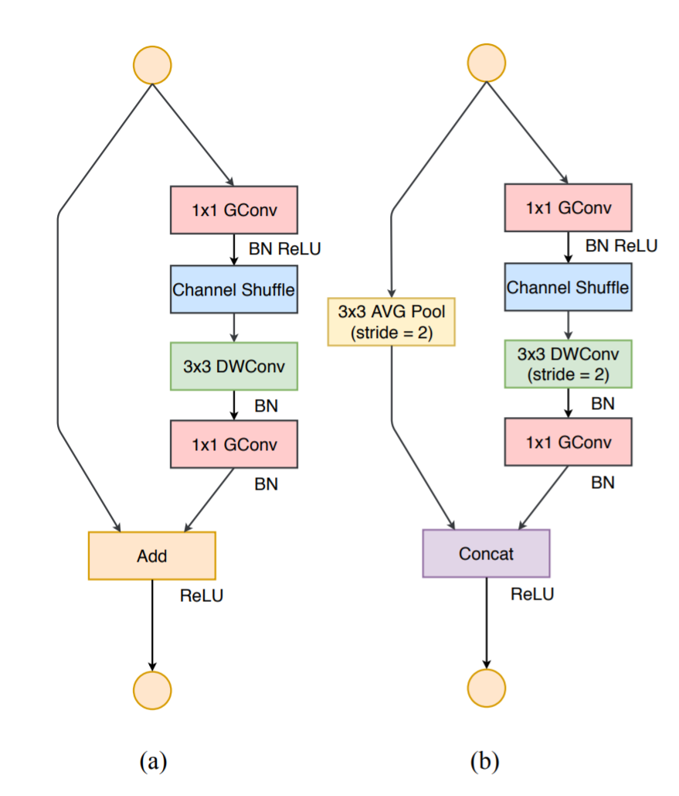
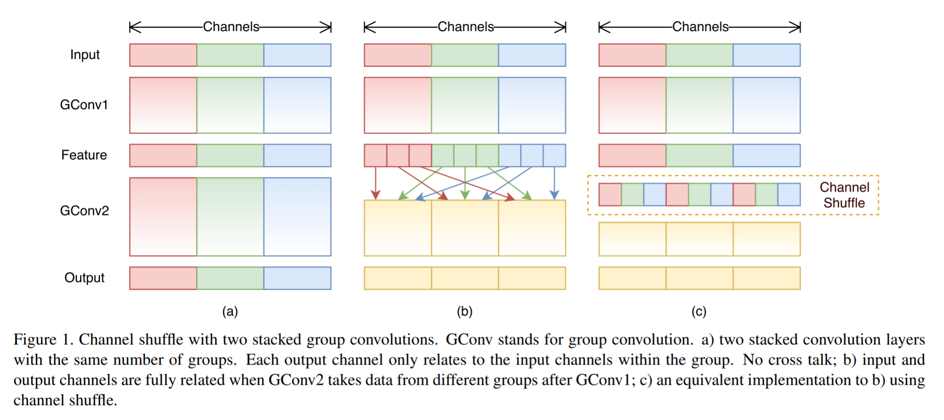
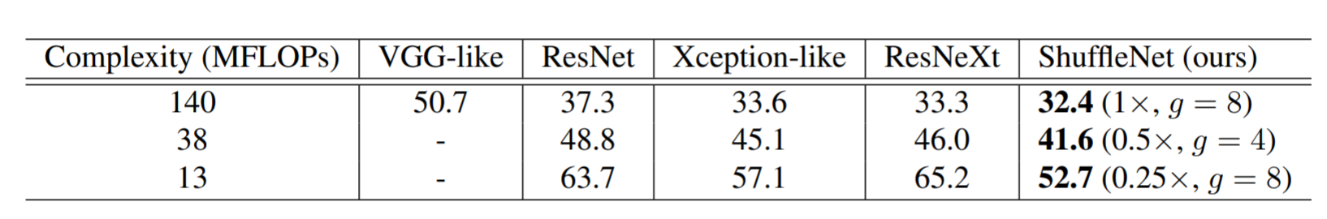
Shuffle Net : further reduce computation for 1x1 conv
1x1 CONV, CxKxHxW multiplications
1x1 group CONV, CxKxHxW /G multiplications
Since every group is processed independently, channel shuffle was added to allow intra-group interaction
Higher accuracy when model complexity is limited
Shuffle net module
ShuffleNet: An Extremely Efficient Convolutional Neural Network for Mobile Devices. https://arxiv.org/abs/1707.01083

Slide 27
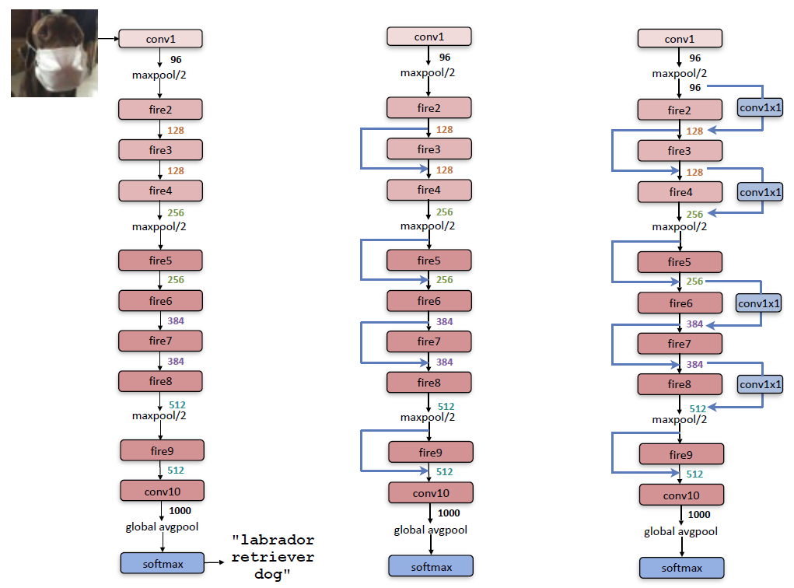
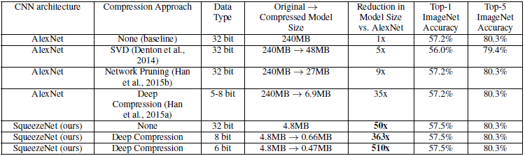
Squeeze net : AlexNet accuracy with 50x less #paras
Reduce memory size and computation while maintaining the performance
Use 1x1 conv
Introduce “fire” module
Reduce the image size at a slower pace for accuracy
CONV, 1x1, K_{1x1,e}
Fire module
Hyperparameters: number of CONV output channels
K_{1x1,s,} K_{1x1,e,} K_{3x3,s}
CONV, 1x1, K_{1x1,s}
Concatenate along channels
CONV, 3x3, K_{3x3,e}
SqueezeNet: AlexNet-level accuracy with 50x fewer parameters and <0.5MB model size. https://arxiv.org/abs/1602.07360

Slide 28
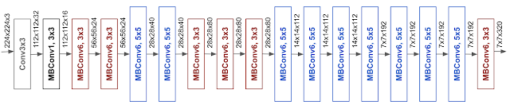
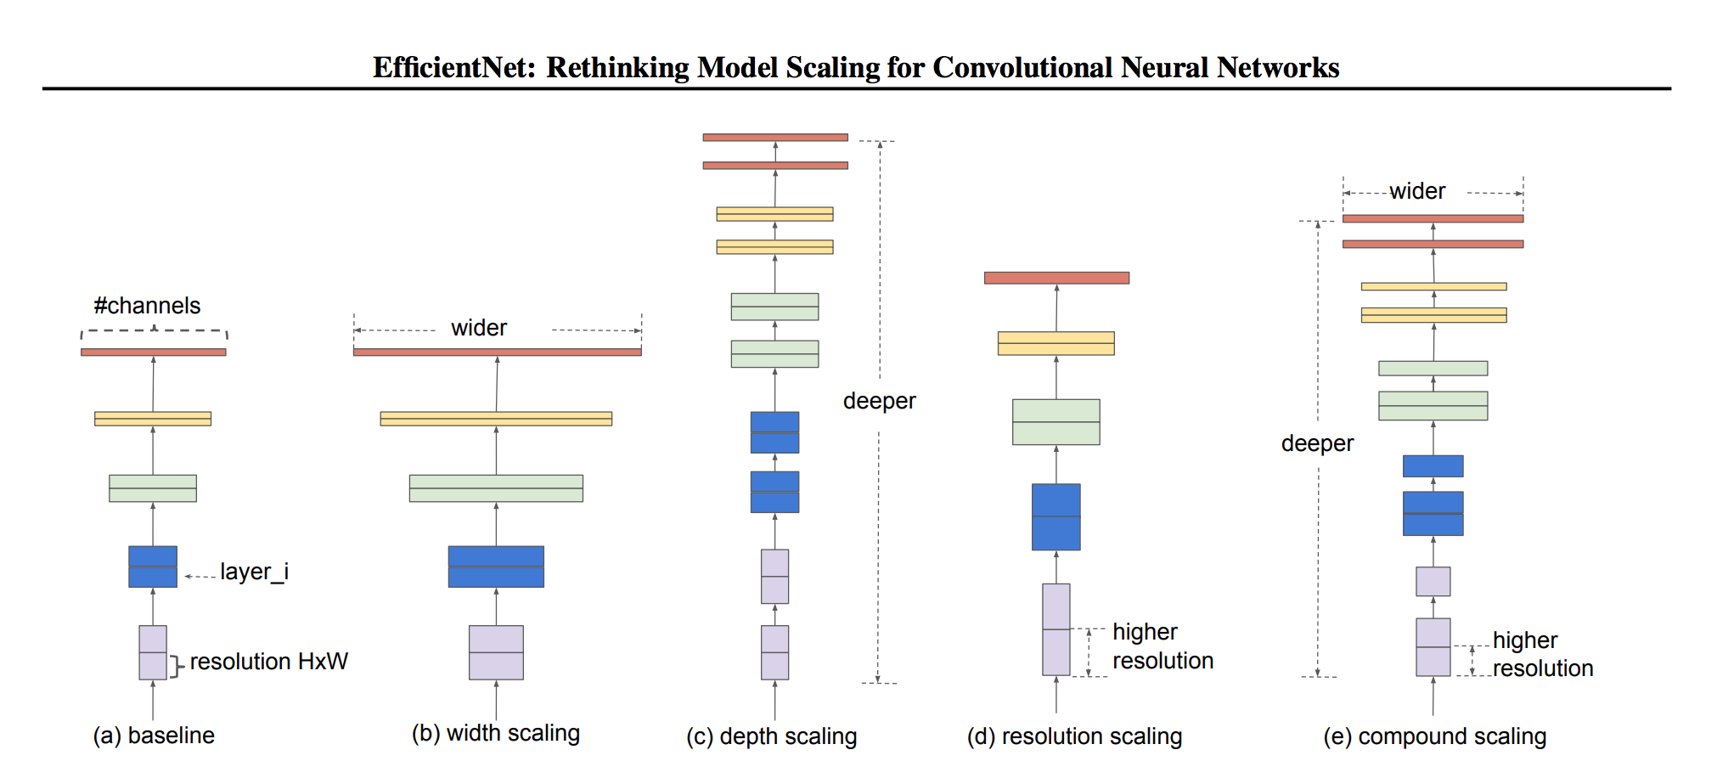
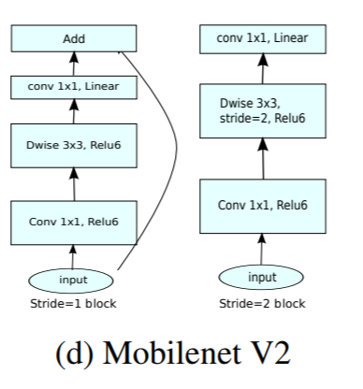
Efficient Net
Systematic way to expand network – depth, width, image resolution
Starting from a base model, search optimal expansion to grow all three aspects together
Use neural architecture search to find a good expansion
MBConv is from MobileNet V2 https://arxiv.org/pdf/1801.04381.pdf
depth :the number of layers in a network
width is the number of neurons in a layer or the number of filters in a convolutional layer
resolution is the height and width of the input tensor
EfficientNet: Rethinking Model Scaling for Convolutional Neural Networks. https://arxiv.org/abs/1905.11946

Slide 29
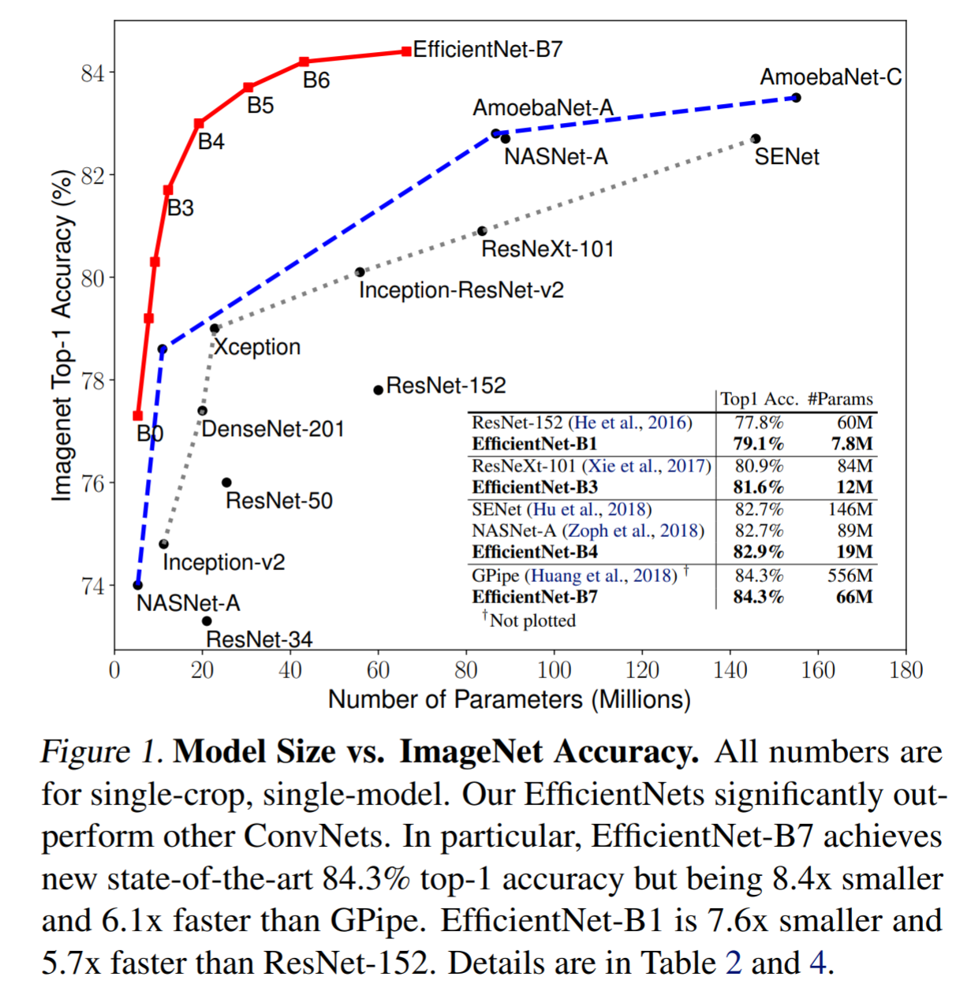
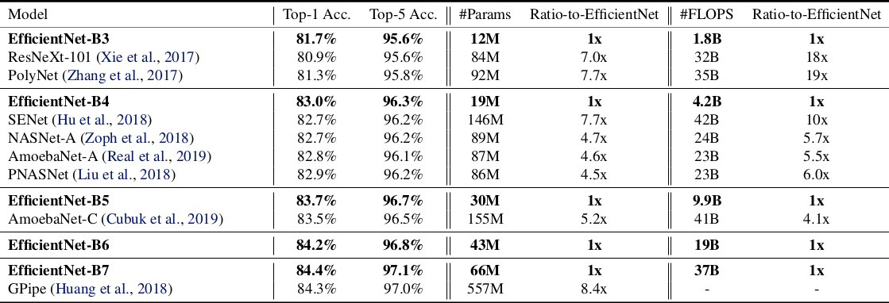
Efficient Net
Scaling up a single aspect quickly saturates the accuracy
Jointly scale up all three aspects achieved top accuracy with reduced model complexity
A systematic approach to design CNN!
EfficientNet: Rethinking Model Scaling for Convolutional Neural Networks. https://arxiv.org/abs/1905.11946

Slide 30
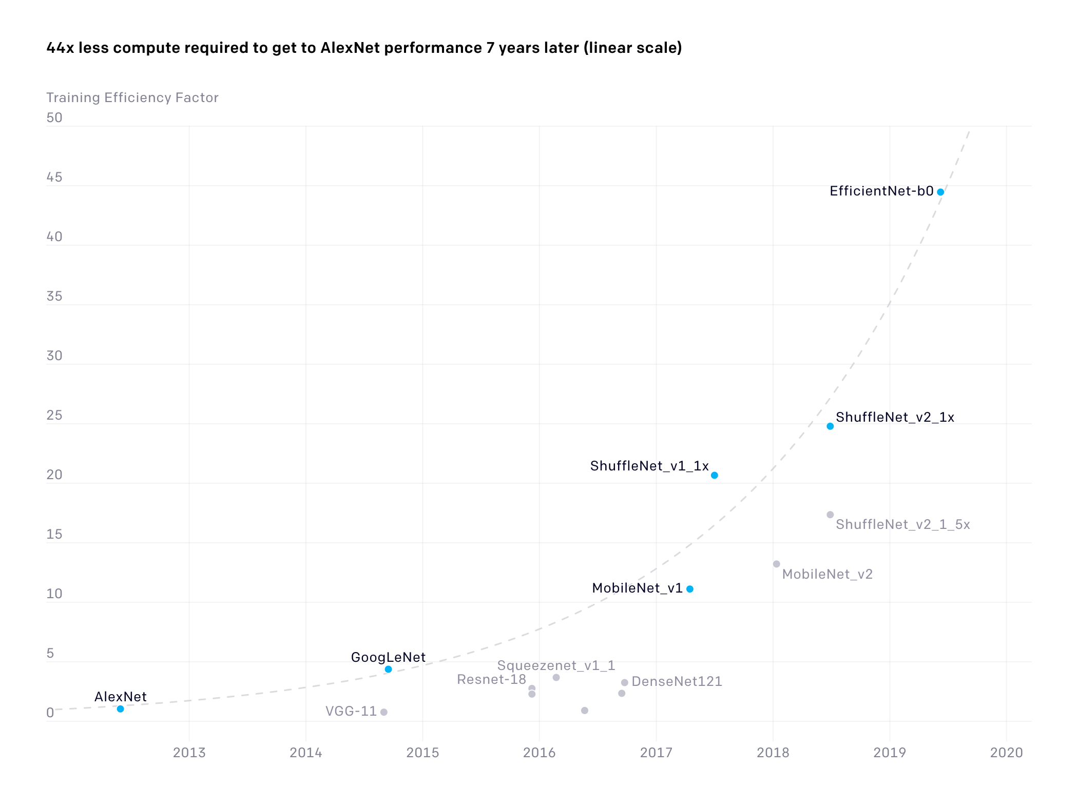
Training efficiency improves
The number of floating-point operations required to train a classifier to AlexNet-level performance on ImageNet
2x reduction every 16 months and in total of 44x reduction of computation, since 2012
Released on May, 2020
https://openai.com/blog/ai-and-efficiency/
Measuring the Algorithmic Efficiency of Neural Networks. https://arxiv.org/abs/2005.04305

Slide 31


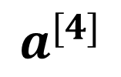
Revisit image classification
red
green
W₁^{[1]}
f
W₁^{[2]}
f
W₁^{[3]}
f
… …
… …
… …
… …
$$X$$
… …
f
… …
f
… …
f
f
W_{k}^{[1]}
W_{k}^{[2]}
W_{k}^{[3]}
W₁^{[4]}
$$a^{[4]}$$
Flatten and concatenate RGB
… …
… …
… …
… …
#parameter?
640x480x3x100+100
~92million …
640x480x3
blue
W_{N}^{[1]}
f
W_{N}^{[2]}
f
W_{N}^{[3]}
f
FC layer is not efficient for image

Slide 32
FC layer is not efficient for image
FC layer is not efficient for image
Too many parameters -> hard to train, easy to get overfitting
Treat all pixels equally; one pixel is connected to all other pixels in the image
Does not utilize the spatial information among neighboring pixels

Slide 33
Spatially invariant feature detection
Edge detection
1 | 0 | -1
2 | 0 | -2
1 | 0 | -1
1 | 2 | 1
0 | 0 | 0
-1 | -2 | -1
Use the same filter “sliding over” the image
Convolution
So no need to have different detectors for the same image features → FC method is not optimal
Sobel filter
Gradient along row
Gradient along column

Slide 34
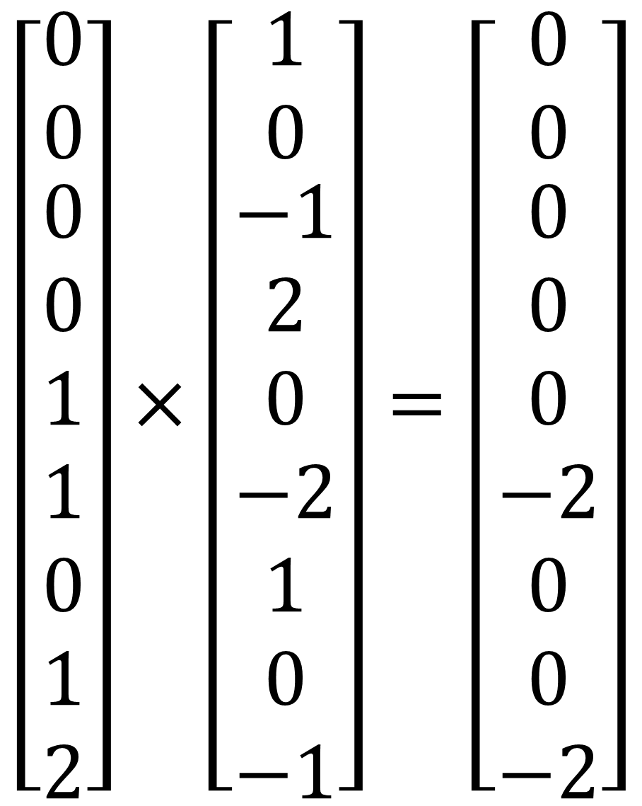
CNN is a spatial-invariant, parameter-sharing FC
Use the convolution operation for spatial invariant → spatial invariant
Use the same filter for the whole image → parameter sharing
1 | 0 | -1
2 | 0 | -2
1 | 0 | -1
$$\left[\begin{matrix}0 \\ 0 \\ \begin{aligned}0 \\ 0 \\ 1 \\ 1 \\ 0 \\ 1 \\ 2\end{aligned}\end{matrix}\right]×\left[\begin{matrix}1 \\ 0 \\ \begin{aligned}−1 \\ 2 \\ 0 \\ −2 \\ 1 \\ 0 \\ −1\end{aligned}\end{matrix}\right]=\left[\begin{matrix}0 \\ 0 \\ \begin{aligned}0 \\ 0 \\ 0 \\ −2 \\ 0 \\ 0 \\ −2\end{aligned}\end{matrix}\right]$$
0 | 0 | 0 | 0 | 0 | 0 | 0 | 0
0 | 1 | 1 | 1 | 1 | 1 | 1 | 0
0 | 1 | 2 | 2 | 2 | 2 | 1 | 0
0 | 1 | 2 | 3 | 3 | 2 | 1 | 0
0 | 1 | 2 | 3 | 3 | 2 | 1 | 0
0 | 1 | 2 | 2 | 2 | 2 | 1 | 0
0 | 1 | 1 | 1 | 1 | 1 | 1 | 0
0 | 0 | 0 | 0 | 0 | 0 | 0 | 0
-4
sum(.)

Slide 35
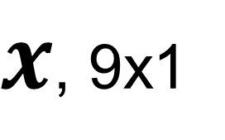
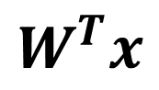
CNN is a spatial-invariant, parameter-sharing FC
Use the convolution operation for spatial invariant → spatial invariant
Use the same filter for the whole image → parameter sharing
1 | 0 | -1
2 | 0 | -2
1 | 0 | -1
0 | 0 | 0 | 0 | 0 | 0 | 0 | 0
0 | 1 | 1 | 1 | 1 | 1 | 1 | 0
0 | 1 | 2 | 2 | 2 | 2 | 1 | 0
0 | 1 | 2 | 3 | 3 | 2 | 1 | 0
0 | 1 | 2 | 3 | 3 | 2 | 1 | 0
0 | 1 | 2 | 2 | 2 | 2 | 1 | 0
0 | 1 | 1 | 1 | 1 | 1 | 1 | 0
0 | 0 | 0 | 0 | 0 | 0 | 0 | 0
$x$, 9x1
-4
$$W^{T}x$$
Take a neighborhood and flatten
Multiple with kernel and sum it up
Can be seen as a local FC

Slide 36
CNN is a spatial-invariant, parameter-sharing FC
Use the convolution operation for spatial invariant → spatial invariant
Use the same filter for the whole image → parameter sharing
1 | 0 | -1
2 | 0 | -2
1 | 0 | -1
0 | 0 | 0 | 0 | 0 | 0 | 0 | 0
0 | 1 | 1 | 1 | 1 | 1 | 1 | 0
0 | 1 | 2 | 2 | 2 | 2 | 1 | 0
0 | 1 | 2 | 3 | 3 | 2 | 1 | 0
0 | 1 | 2 | 3 | 3 | 2 | 1 | 0
0 | 1 | 2 | 2 | 2 | 2 | 1 | 0
0 | 1 | 1 | 1 | 1 | 1 | 1 | 0
0 | 0 | 0 | 0 | 0 | 0 | 0 | 0
$x$, 9x1
-4 | -1
$$W^{T}x$$

Slide 37
CNN is a spatial-invariant, parameter-sharing FC
Use the convolution operation for spatial invariant → spatial invariant
Use the same filter for the whole image → parameter sharing
1 | 0 | -1
2 | 0 | -2
1 | 0 | -1
0 | 0 | 0 | 0 | 0 | 0 | 0 | 0
0 | 1 | 1 | 1 | 1 | 1 | 1 | 0
0 | 1 | 2 | 2 | 2 | 2 | 1 | 0
0 | 1 | 2 | 3 | 3 | 2 | 1 | 0
0 | 1 | 2 | 3 | 3 | 2 | 1 | 0
0 | 1 | 2 | 2 | 2 | 2 | 1 | 0
0 | 1 | 1 | 1 | 1 | 1 | 1 | 0
0 | 0 | 0 | 0 | 0 | 0 | 0 | 0
$x$, 9x1
-4 | -1 | 0
$$W^{T}x$$

Slide 38
CNN is a spatial-invariant, parameter-sharing FC
Use the convolution operation for spatial invariant → spatial invariant
Use the same filter for the whole image → parameter sharing
1 | 0 | -1
2 | 0 | -2
1 | 0 | -1
0 | 0 | 0 | 0 | 0 | 0 | 0 | 0
0 | 1 | 1 | 1 | 1 | 1 | 1 | 0
0 | 1 | 2 | 2 | 2 | 2 | 1 | 0
0 | 1 | 2 | 3 | 3 | 2 | 1 | 0
0 | 1 | 2 | 3 | 3 | 2 | 1 | 0
0 | 1 | 2 | 2 | 2 | 2 | 1 | 0
0 | 1 | 1 | 1 | 1 | 1 | 1 | 0
0 | 0 | 0 | 0 | 0 | 0 | 0 | 0
$x$, 9x1
-4 | -1 | 0 | 0
$$W^{T}x$$

Slide 39
CNN is a spatial-invariant, parameter-sharing FC
Use the convolution operation for spatial invariant → spatial invariant
Use the same filter for the whole image → parameter sharing
1 | 0 | -1
2 | 0 | -2
1 | 0 | -1
0 | 0 | 0 | 0 | 0 | 0 | 0 | 0
0 | 1 | 1 | 1 | 1 | 1 | 1 | 0
0 | 1 | 2 | 2 | 2 | 2 | 1 | 0
0 | 1 | 2 | 3 | 3 | 2 | 1 | 0
0 | 1 | 2 | 3 | 3 | 2 | 1 | 0
0 | 1 | 2 | 2 | 2 | 2 | 1 | 0
0 | 1 | 1 | 1 | 1 | 1 | 1 | 0
0 | 0 | 0 | 0 | 0 | 0 | 0 | 0
$x$, 9x1
-4 | -1 | 0 | 0 | 1
$$W^{T}x$$

Slide 40
CNN is a spatial-invariant, parameter-sharing FC
Use the convolution operation for spatial invariant → spatial invariant
Use the same filter for the whole image → parameter sharing
1 | 0 | -1
2 | 0 | -2
1 | 0 | -1
0 | 0 | 0 | 0 | 0 | 0 | 0 | 0
0 | 1 | 1 | 1 | 1 | 1 | 1 | 0
0 | 1 | 2 | 2 | 2 | 2 | 1 | 0
0 | 1 | 2 | 3 | 3 | 2 | 1 | 0
0 | 1 | 2 | 3 | 3 | 2 | 1 | 0
0 | 1 | 2 | 2 | 2 | 2 | 1 | 0
0 | 1 | 1 | 1 | 1 | 1 | 1 | 0
0 | 0 | 0 | 0 | 0 | 0 | 0 | 0
$x$, 9x1
-4 | -1 | 0 | 0 | 1 | 4
$$W^{T}x$$

Slide 41
CNN is a spatial-invariant, parameter-sharing FC
Use the convolution operation for spatial invariant → spatial invariant
Use the same filter for the whole image → parameter sharing
1 | 0 | -1
2 | 0 | -2
1 | 0 | -1
0 | 0 | 0 | 0 | 0 | 0 | 0 | 0
0 | 1 | 1 | 1 | 1 | 1 | 1 | 0
0 | 1 | 2 | 2 | 2 | 2 | 1 | 0
0 | 1 | 2 | 3 | 3 | 2 | 1 | 0
0 | 1 | 2 | 3 | 3 | 2 | 1 | 0
0 | 1 | 2 | 2 | 2 | 2 | 1 | 0
0 | 1 | 1 | 1 | 1 | 1 | 1 | 0
0 | 0 | 0 | 0 | 0 | 0 | 0 | 0
$x$, 9x1
-4 | -1 | 0 | 0 | 1 | 4
-7
$$W^{T}x$$

Slide 42
CNN is a spatial-invariant, parameter-sharing FC
Use the convolution operation for spatial invariant → spatial invariant
Use the same filter for the whole image → parameter sharing
1 | 0 | -1
2 | 0 | -2
1 | 0 | -1
0 | 0 | 0 | 0 | 0 | 0 | 0 | 0
0 | 1 | 1 | 1 | 1 | 1 | 1 | 0
0 | 1 | 2 | 2 | 2 | 2 | 1 | 0
0 | 1 | 2 | 3 | 3 | 2 | 1 | 0
0 | 1 | 2 | 3 | 3 | 2 | 1 | 0
0 | 1 | 2 | 2 | 2 | 2 | 1 | 0
0 | 1 | 1 | 1 | 1 | 1 | 1 | 0
0 | 0 | 0 | 0 | 0 | 0 | 0 | 0
$x$, 9x1
-4 | -1 | 0 | 0 | 1 | 4
-7 | -4
$$W^{T}x$$

Slide 43
CNN is a spatial-invariant, parameter-sharing FC
Use the convolution operation for spatial invariant → spatial invariant
Use the same filter for the whole image → parameter sharing
1 | 0 | -1
2 | 0 | -2
1 | 0 | -1
0 | 0 | 0 | 0 | 0 | 0 | 0 | 0
0 | 1 | 1 | 1 | 1 | 1 | 1 | 0
0 | 1 | 2 | 2 | 2 | 2 | 1 | 0
0 | 1 | 2 | 3 | 3 | 2 | 1 | 0
0 | 1 | 2 | 3 | 3 | 2 | 1 | 0
0 | 1 | 2 | 2 | 2 | 2 | 1 | 0
0 | 1 | 1 | 1 | 1 | 1 | 1 | 0
0 | 0 | 0 | 0 | 0 | 0 | 0 | 0
$x$, 9x1
-4 | -1 | 0 | 0 | 1 | 4
-7 | -4 | -1 | 1 | 4 | 7
-8 | -7 | -3 | 3 | 7 | 8
-8 | -7 | -3 | 3 | 7 | 8
-7 | -4 | -1 | 1 | 4 | 7
-4 | -1 | 0 | 0 | 1 | 4
$$W^{T}x$$

Slide 44
CNN is a spatial-invariant, parameter-sharing FC
Use the convolution operation for spatial invariant → spatial invariant
Use the same filter for the whole image → parameter sharing
1 | 0 | -1
2 | 0 | -2
1 | 0 | -1
0 | 0 | 0 | 0 | 0 | 0 | 0 | 0
0 | 1 | 1 | 1 | 1 | 1 | 1 | 0
0 | 1 | 2 | 2 | 2 | 2 | 1 | 0
0 | 1 | 2 | 3 | 3 | 2 | 1 | 0
0 | 1 | 2 | 3 | 3 | 2 | 1 | 0
0 | 1 | 2 | 2 | 2 | 2 | 1 | 0
0 | 1 | 1 | 1 | 1 | 1 | 1 | 0
0 | 0 | 0 | 0 | 0 | 0 | 0 | 0
Higher value in outputs indicate “vertical edges”
With direction information (gradient direction)
$x$, 9x1
-4 | -1 | 0 | 0 | 1 | 4
-7 | -4 | -1 | 1 | 4 | 7
-8 | -7 | -3 | 3 | 7 | 8
-8 | -7 | -3 | 3 | 7 | 8
-7 | -4 | -1 | 1 | 4 | 7
-4 | -1 | 0 | 0 | 1 | 4
$$W^{T}x$$

Slide 45
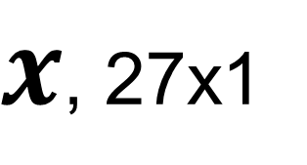

CNN layer with multiple channels
Kernel has multiple channels too
Sum over all channels
Image: $H×W×C$
Kernel: $k_{x}×k_{y}×C$
1 | 0 | -1
2 | 0 | -2
1 | 0 | -1
0 | 0 | 0 | 0 | 0 | 0 | 0 | 0
0 | 1 | 1 | 1 | 1 | 1 | 1 | 0
0 | 1 | 2 | 2 | 2 | 2 | 1 | 0
0 | 1 | 2 | 3 | 3 | 2 | 1 | 0
0 | 1 | 2 | 3 | 3 | 2 | 1 | 0
0 | 1 | 2 | 2 | 2 | 2 | 1 | 0
0 | 1 | 1 | 1 | 1 | 1 | 1 | 0
0 | 0 | 0 | 0 | 0 | 0 | 0 | 0
$x$, 27x1
0
$$W^{T}x$$

Slide 46
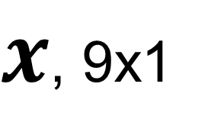
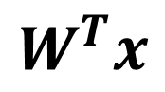
Padding
Pixels on the boundary was not explored
Reduced output size
1 | 0 | -1
2 | 0 | -2
1 | 0 | -1
Padding = 1
 |  |  | 0 | 0 | 0 | 0 | 0 | 0 | 0
 | 0 | 0 | 0 | 0 | 0 | 0 | 0 | 0 | 0
 | 0 | 1 | 1 | 1 | 1 | 1 | 1 | 0 | 0
0 | 0 | 1 | 2 | 2 | 2 | 2 | 1 | 0 | 0
0 | 0 | 1 | 2 | 3 | 3 | 2 | 1 | 0 | 0
0 | 0 | 1 | 2 | 3 | 3 | 2 | 1 | 0 | 0
0 | 0 | 1 | 2 | 2 | 2 | 2 | 1 | 0 | 0
0 | 0 | 1 | 1 | 1 | 1 | 1 | 1 | 0 | 0
0 | 0 | 0 | 0 | 0 | 0 | 0 | 0 | 0 | 0
0 | 0 | 0 | 0 | 0 | 0 | 0 | 0 | 0 | 0
0 | 0 | 0
0
0
-1 | -1 | 0 | 0 | 0 | 0 | 1 | 1
-3 | -4 | -1 | 0 | 0 | 1 | 4 | -3
-4 | -7 | -4 | -1 | 1 | 4 | 7 | -4
-4 | -8 | -7 | -3 | 3 | 7 | 8 | -4
-4 | -8 | -7 | -3 | 3 | 7 | 8 | -4
-4 | -7 | -4 | -1 | 1 | 4 | 7 | -4
-3 | -4 | -1 | 0 | 0 | 1 | 4 | -3
-1 | -1 | 0 | 0 | 0 | 0 | 1 | 1
$x$, 9x1
$$W^{T}x$$
Often pad with 0
Other choices : replica, mirror, periodic

Slide 47
Stride
When sliding the kernel over the image, the moving stepsize is the stride
Default is 1, but stride can be larger than 1
Often used to reduce output size
Stride=2 along row
0 | 0 | 0 | 0 | 0 | 0 | 0 | 0
0 | 1 | 1 | 1 | 1 | 1 | 1 | 0
0 | 1 | 2 | 2 | 2 | 2 | 1 | 0
0 | 1 | 2 | 3 | 3 | 2 | 1 | 0
0 | 1 | 2 | 3 | 3 | 2 | 1 | 0
0 | 1 | 2 | 2 | 2 | 2 | 1 | 0
0 | 1 | 1 | 1 | 1 | 1 | 1 | 0
0 | 0 | 0 | 0 | 0 | 0 | 0 | 0
$x$, 9x1
-4 |  | 0
$$W^{T}x$$

Slide 48
Stride
When sliding the kernel over the image, the moving stepsize is the stride
Default is 1, but stride can be larger than 1
Often used to reduce output size
Stride=2 along column
0 | 0 | 0 | 0 | 0 | 0 | 0 | 0
0 | 1 | 1 | 1 | 1 | 1 | 1 | 0
0 | 1 | 2 | 2 | 2 | 2 | 1 | 0
0 | 1 | 2 | 3 | 3 | 2 | 1 | 0
0 | 1 | 2 | 3 | 3 | 2 | 1 | 0
0 | 1 | 2 | 2 | 2 | 2 | 1 | 0
0 | 1 | 1 | 1 | 1 | 1 | 1 | 0
0 | 0 | 0 | 0 | 0 | 0 | 0 | 0
$x$, 9x1
-4
-8
$$W^{T}x$$

Slide 49
Stride
When sliding the kernel over the image, the moving stepsize is the stride
Default is 1, but stride can be larger than 1
Often used to reduce output size
Input 8x8
Kernel 3x3
Output 3x3
With padding=0, stride=2 for H and W
0 | 0 | 0 | 0 | 0 | 0 | 0 | 0
0 | 1 | 1 | 1 | 1 | 1 | 1 | 0
0 | 1 | 2 | 2 | 2 | 2 | 1 | 0
0 | 1 | 2 | 3 | 3 | 2 | 1 | 0
0 | 1 | 2 | 3 | 3 | 2 | 1 | 0
0 | 1 | 2 | 2 | 2 | 2 | 1 | 0
0 | 1 | 1 | 1 | 1 | 1 | 1 | 0
0 | 0 | 0 | 0 | 0 | 0 | 0 | 0
$x$, 9x1
-4 |  | 0 |  | 1
-8 |  | -3 |  | 7
-7 |  | -1 |  | 4
$$W^{T}x$$

Slide 50
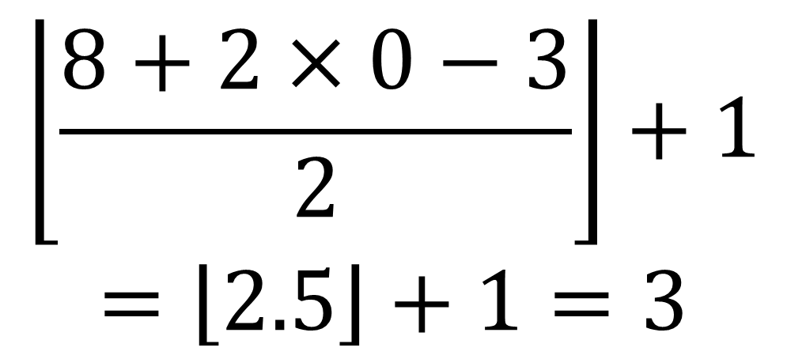


Determine the output size
Output size:
$$H^{′}=\left\lfloor \left.\frac{H+2×p−k_{x}}{s}\right\rfloor \right.+1$$
$$W^{′}=\left\lfloor \left.\frac{W+2×p−k_{y}}{s}\right\rfloor \right.+1$$
Image: $H×W×C$
Kernel: $k_{x}×k_{y}×C$
Padding size: $p$
Stride: $s$
$$\left\lfloor \left.\frac{8+2×0−3}{2}\right\rfloor \right.+1$$
$$=\left\lfloor \left.2.5\right\rfloor \right.+1=3$$
0 | 0 | 0 | 0 | 0 | 0 | 0 | 0
0 | 1 | 1 | 1 | 1 | 1 | 1 | 0
0 | 1 | 2 | 2 | 2 | 2 | 1 | 0
0 | 1 | 2 | 3 | 3 | 2 | 1 | 0
0 | 1 | 2 | 3 | 3 | 2 | 1 | 0
0 | 1 | 2 | 2 | 2 | 2 | 1 | 0
0 | 1 | 1 | 1 | 1 | 1 | 1 | 0
0 | 0 | 0 | 0 | 0 | 0 | 0 | 0
$x$, 9x1
-4 |  | 0 |  | 1
-8 |  | -3 |  | 7
-7 |  | -1 |  | 4
Stride can be used to reduce image size
$$W^{T}x$$

Slide 51















Multiple kernels
For one location in the image, multiple kernels can be used to capture different features
Image: $H×W×C$
Kernel: $k_{x}×k_{y}×C×K$
Output : $H^{′}×W^{′}×K$
1 | 0 | -1
2 | 0 | -2
1 | 0 | -1
1 | 2 | 1
0 | 0 | 0
-1 | -2 | -1
1 | 0 | 0
0 | 1 | 0
0 | 0 | 1
1 | 1 | 0
1 | 0 | 0
0 | 0 | 0
$$W_{1}$$
$$W_{2}$$
$$W_{3}$$
$$W_{4}$$
These kernels are learned
$C$ : input channels
$K$ : output channels
With K bias parameters; one for each output channel
0 | 0 | 0 | 0 | 0 | 0 | 0 | 0
0 | 1 | 1 | 1 | 1 | 1 | 1 | 0
0 | 1 | 2 | 2 | 2 | 2 | 1 | 0
0 | 1 | 2 | 3 | 3 | 2 | 1 | 0
0 | 1 | 2 | 3 | 3 | 2 | 1 | 0
0 | 1 | 2 | 2 | 2 | 2 | 1 | 0
0 | 1 | 1 | 1 | 1 | 1 | 1 | 0
0 | 0 | 0 | 0 | 0 | 0 | 0 | 0
$x$, 27x1
$$W_{1}^{T}x$$
$x$, 27x1
$$W_{2}^{T}x$$
Feature maps
$x$, 27x1
$x$, 27x1
$$W_{3}^{T}x$$
$$W_{4}^{T}x$$
How many parameters?
$$k_{x}×k_{y}×C×K+K$$

Slide 52

Multiple CONV layers can be stacked
Nonlinearity (e.g. ReLU) is applied to every element on feature maps
$$\left\lfloor \left.\frac{640+2×3−7}{2}\right\rfloor \right.+1=320$$
$$\left\lfloor \left.\frac{480+2×3−7}{2}\right\rfloor \right.+1=240$$
3x640x480
Kernel: 7x7x3x16,
16 biases
CONV
7x7, p=3, s=2, K=16
16x320x240
Total number of parameters:
7x7x3x16+16+5x5x16x32+32+3x3x32x64+64+256x307200+256+1x256+1 = 78,677409, ~78million
One FC layer claims 99.96%
ReLU
16x320x240
logit
Kernel: 5x5x16x32,
32 biases
W: 1x256,
1 biases
CONV
5x5, p=2, s=2 , K=32
FC, D=1
32x160x120
256x1
ReLU
32x160x120
Kernel: 3x3x32x64,
64 biases
ReLU
W: 256x307200,
256 biases
FC, D=256
CONV
3x3, p=1, s=2 , K=64
64x80x60
307200x1
ReLU
Flatten
64x80x60

Slide 53
Receptive field
Every CONV filter looks at a small neighborhood
May need to look at more global structure in the image?
Receptive field : the region in the image to impact a feature after some CONV layers
8x8x3
Kernel:
3x3x1, p=0, s=1
Kernel:
3x3x1, p=0, s=1
0 | 0 | 0 | 0 | 0 | 0 | 0 | 0
0 | 1 | 1 | 1 | 1 | 1 | 1 | 0
0 | 1 | 2 | 2 | 2 | 2 | 1 | 0
0 | 1 | 2 | 3 | 3 | 2 | 1 | 0
0 | 1 | 2 | 3 | 3 | 2 | 1 | 0
0 | 1 | 2 | 2 | 2 | 2 | 1 | 0
0 | 1 | 1 | 1 | 1 | 1 | 1 | 0
0 | 0 | 0 | 0 | 0 | 0 | 0 | 0
With deeper network, the receptive field increases

Slide 54


1D and 3D convolution
Computation is the same as the 2D CONV
0 | 0 | 0 | 0 | 0 | 0 | 0 | 0
0 | 1 | 1 | 1 | 1 | 1 | 1 | 0
0 | 1 | 2 | 2 | 2 | 2 | 1 | 0
0 | 1 | 2 | 3 | 3 | 2 | 1 | 0
0 | 1 | 2 | 3 | 3 | 2 | 1 | 0
0 | 1 | 2 | 2 | 2 | 2 | 1 | 0
0 | 1 | 1 | 1 | 1 | 1 | 1 | 0
0 | 0 | 0 | 0 | 0 | 0 | 0 | 0
1 | 0 | -1
0 | 1 | 2 | 3 | 3 | 2 | 1 | 0
Image: $H×W×D×C$
Kernel: $k_{x}×k_{y}×k_{z}×C×K$
Output : $H^{′}×W^{′}×D^{′}×K$
Padding along three dimensions
Image: $L×C$
Kernel: $k×C×K$
Output : $L^{′}×K$
Padding along two ends

Slide 55






Dilated convolution
Increase receptive field by “skipping pixels” in input images
$$k_{x}×k_{y}$$
Dilate kernel with the dilation rate 1
$$[k_{x}+d\left(k_{x}−1\right)]×[k_{y}+d\left(k_{y}−1\right)]$$
1 |  | 0 |  | -1
2 |  | 0 |  | -2
1 |  | 0 |  | -1
1 | 0 | -1
2 | 0 | -2
1 | 0 | -1
0 | 0 | 0 | 0 | 0 | 0 | 0 | 0
0 | 1 | 1 | 1 | 1 | 1 | 1 | 0
0 | 1 | 2 | 2 | 2 | 2 | 1 | 0
0 | 1 | 2 | 3 | 3 | 2 | 1 | 0
0 | 1 | 2 | 3 | 3 | 2 | 1 | 0
0 | 1 | 2 | 2 | 2 | 2 | 1 | 0
0 | 1 | 1 | 1 | 1 | 1 | 1 | 0
0 | 0 | 0 | 0 | 0 | 0 | 0 | 0
[1 1 1 1 3 2 1 2 2]
X
[1 0 -1 2 0 -2 1 0 -1]^{T} = -3
$x$, 9x1
$$W^{T}x$$
Then convolve with dilated kernel, but only count the $k_{x}×k_{y}$ locations
Input: 7x7, padding 0, stride 1
dilation rate 1, kernel 3x3
Output:3x3, $\left\lfloor \frac{7+2×0−[3+1×\left(3−1\right)]}{1}\right\rfloor +1=3$
Animation is from https://github.com/vdumoulin/conv_arithmetic

Slide 56


Transpose convolution
Increase image size after convolution – often used to upsample feature maps
Input: 2x2, padding 0, stride 1
Kernel: 3x3
Required Output:4x4
Determine padding size
Sliding over the output
For every location in output, take the corresponding pixels in input maps and apply the kernel
What is the padding size p?
$$\left\lfloor \frac{2+2×p−3}{1}\right\rfloor +1=4$$
$$p=2$$
Animation is from https://github.com/vdumoulin/conv_arithmetic

Slide 57


Transpose convolution
Increase image size after convolution – often used to upsample feature maps
Input: 6x6, padding 0, stride 1
Kernel: 4x4
Required Output:5x5
Determine padding size
Sliding over the output
For every location in output, take the corresponding pixels in input maps and apply the kernel
What is the padding size p?
$$\left\lfloor \frac{6+2×p−4}{1}\right\rfloor +1=5$$
$$p=1$$
Animation is from https://github.com/vdumoulin/conv_arithmetic

Slide 58





Convolution is shift-invariant, not for rotation and scale
CONV cannot deal with arbitrary spatial transformation
More general, the training and test sets can have different distribution
conv
conv
Training set, cats are roughly the same size
A test sample, small cat

Slide 59


Data augmentation
Introduce variation in the training data, so model can learn invariance
Randomly apply different transformations
And many more …
Check http://ai.stanford.edu/blog/data-augmentation/

Slide 60


Data augmentation
Do not generate these random samples and save them
Instead, implement them as a part of data loading
T₁
_{P=0.5}
T₂
_{P=0.8}
T₃
_{P=0.2}
T_{N}
_{P=0.5}
… …
Input to training
P: probability to apply the transformation
More examples can be found at https://pytorch.org/vision/stable/auto_examples/plot_transforms.html#sphx-glr-auto-examples-plot-transforms-py

Slide 61

Pooling : another way to reduce computation
Often used to reduce the image size
Parameter free
Input: 8x8
Pool size: 2x2
Take every 2x2 neighborhood, compute its max (max pool) or average (averaging pool)
Typically, no padding, stride equals to the pool_size
0 | 0 | 0 | 0 | 0 | 0 | 0 | 0
0 | 1 | 1 | 1 | 1 | 1 | 1 | 0
0 | 1 | 2 | 2 | 2 | 2 | 1 | 0
0 | 1 | 2 | 3 | 3 | 2 | 1 | 0
0 | 1 | 2 | 3 | 3 | 2 | 1 | 0
0 | 1 | 2 | 2 | 2 | 2 | 1 | 0
0 | 1 | 1 | 1 | 1 | 1 | 1 | 0
0 | 0 | 0 | 0 | 0 | 0 | 0 | 0
1
Max pool
Output size
$$\left\lfloor \frac{H−pool_size}{pool_size}\right\rfloor +1$$

Slide 62
Pooling : another way to reduce computation
Often used to reduce the image size
Parameter free
Input: 8x8
Pool size: 2x2
Take every 2x2 neighborhood, compute its max (max pool) or average (averaging pool)
Typically, no padding, stride equals to the pool_size
0 | 0 | 0 | 0 | 0 | 0 | 0 | 0
0 | 1 | 1 | 1 | 1 | 1 | 1 | 0
0 | 1 | 2 | 2 | 2 | 2 | 1 | 0
0 | 1 | 2 | 3 | 3 | 2 | 1 | 0
0 | 1 | 2 | 3 | 3 | 2 | 1 | 0
0 | 1 | 2 | 2 | 2 | 2 | 1 | 0
0 | 1 | 1 | 1 | 1 | 1 | 1 | 0
0 | 0 | 0 | 0 | 0 | 0 | 0 | 0
1 | 1 | 1 | 1
1 | 3
Max pool
Output size
$$\left\lfloor \frac{H−pool_size}{pool_size}\right\rfloor +1$$

Slide 63
Pooling : another way to reduce computation
Often used to reduce the image size
Parameter free
Input: 8x8
Pool size: 2x2
Take every 2x2 neighborhood, compute its max (max pool) or average (averaging pool)
Typically, no padding, stride equals to the pool_size
0 | 0 | 0 | 0 | 0 | 0 | 0 | 0
0 | 1 | 1 | 1 | 1 | 1 | 1 | 0
0 | 1 | 2 | 2 | 2 | 2 | 1 | 0
0 | 1 | 2 | 3 | 3 | 2 | 1 | 0
0 | 1 | 2 | 3 | 3 | 2 | 1 | 0
0 | 1 | 2 | 2 | 2 | 2 | 1 | 0
0 | 1 | 1 | 1 | 1 | 1 | 1 | 0
0 | 0 | 0 | 0 | 0 | 0 | 0 | 0
1 | 1 | 1 | 1
1 | 3 | 3 | 1
1 | 3 | 3 | 1
1 | 1 | 1 | 1
Max pool
Output size
$$\left\lfloor \frac{H−pool_size}{pool_size}\right\rfloor +1$$
2x2 is the most typical choice

Slide 64


Use interpolation to resize images
Another “parameter free” way to resize images
It is a layer in NN
Differentiable by remembering the interpolation weights
Interpolation: use neighboring pixels to determine value of unknown location (weighted sum)
Weights depend on pixel location; no learnable parameters
https://www.quora.com/What-is-bicubic-interpolation-in-image-processing

Slide 65
Layers to adjust image size
Layers | Downsample | Upsample | Pro/Cons
Stride CONV | Yes | No | Same as normal conv, fast to compute
Pooling | Yes | No | Fast to compute, reduce the model power, less popular nowadays
Interpolation | Yes | Yes | Parameter free, fast to compute
Transpose CONV | Yes, but often not used for this | Yes | Has learnable parameters for upsampling
Pooling still is used in classification tasks
Full CONV architecture are more popular for other tasks, e.g. segmentation, super-resolution, denoising …

Slide 66




Batch Normalization
Features with varying magnitude
Features with normalized magnitude
$$\frac{dℓ}{dw_{1}}=\frac{dℓ}{dy}x_{1}$$
$$\frac{dℓ}{dw_{3}}=\frac{dℓ}{dy}x_{3}$$
Features with unnormalized magnitude leads to harder optimization
$y=w_{1}x_{1}+w_{2}x_{2}$+ $w_{3}x_{3}$
$$\frac{dℓ}{dw_{2}}=\frac{dℓ}{dy}x_{2}$$

Slide 67
Batch Normalization
Techniques to battle unnormalized features
Data pre-processing, whitening …
Model parameter initialization (e.g. He and Xavier)
Model will be well-behaved at the beginning of training
No guarantee for later epochs
No guarantee for deeper layers
Almost guaranteed to deviate
CONV
ReLU
CONV
ReLU
CONV
ReLU
Flatten
FC
ReLU
FC
logits
Normalized after data pre-processing
Output of previous layer is the input to the next layer
Deviated from normalized features

Slide 68





Batch Normalization: if we need normalized features, add a layer to enforce it
Add a specific layer to normalize the output of previous layer
Give a mini-batch, $X=\left\{\begin{matrix}x^{\{1\}} & x^{\{2\}} & x^{\{3\}}\end{matrix} \begin{matrix}⋯ & ⋯ & x^{\{B\}}\end{matrix}\right\}$
Every sample $x^{\{k\}}$ is a Nx1 vector or CxHxW image
${\hat{x}}^{\{k\}}$ is the Nx1 vector or CxHxW image, same as $x^{\{k\}}$
$μ$ and $δ$ are per-dimentional mean and variance
Compute mean of this batch
Compute variance of this batch
$$μ=\frac{1}{B}\sum_{k=1}^{B}{x^{\{k\}}}$$
$$δ^{2}=\frac{1}{B}\sum_{k=1}^{B}{{\left[x^{\{k\}}−μ\right]}^{2}}$$
Normalize the batch
$${\hat{x}}^{\{k\}}=\frac{x^{\{k\}}−μ}{\sqrt[2]{δ^{2}+ε}}$$
Element-wise operation
Batch Normalization: Accelerating Deep Network Training by Reducing Internal Covariate Shift. https://arxiv.org/abs/1502.03167

Slide 69








Batch Normalization: if we need normalized features, add a layer to enforce it
Give a mini-batch, $X=\left\{\begin{matrix}x^{\{1\}} & x^{\{2\}} & x^{\{3\}}\end{matrix} \begin{matrix}⋯ & ⋯ & x^{\{B\}}\end{matrix}\right\}$
$x^{\{k\}}$ is a Nx1 vector or CxHxW image
Normalization reduces the representation power of model
To restore the representation power, introduce two learnable parameters
$$μ=\frac{1}{B}\sum_{k=1}^{B}{x^{\{k\}}}$$
$$δ^{2}=\frac{1}{B}\sum_{k=1}^{B}{{\left[x^{\{k\}}−μ\right]}^{2}}$$
At training time,
Given a mini-batch, compute mean and variance
Compute $\hat{x}$ and $y$, using $γ$ and $β$ and $μ$ and $δ$
Therefore, if batch size is too small (e.g. <16), BN may not work well
$${\hat{x}}^{\{k\}}=\frac{x^{\{k\}}−μ}{\sqrt[2]{δ^{2}+ε}}$$
$γ$ and $β$ are the same dimension as $x^{\{k\}}$
$$y^{\{k\}}=γ∘{\hat{x}}^{\left\{k\right\}}+β$$
${\hat{x}}^{\{k\}}=$ $x^{\{k\}}$ if $γ=$ $δ$and $β=μ$
Batch Normalization: Accelerating Deep Network Training by Reducing Internal Covariate Shift. https://arxiv.org/abs/1502.03167

Slide 70









Batch Normalization: if we need normalized features, add a layer to enforce it
At training time,
Given a mini-batch, compute $μ$ and $δ$ from this batch
Compute $\hat{x}$ and $y$, using $γ$ and $β$ and $μ$ and $δ$
At test time,
We don’t have a mini-batch, often B=1
The assumption behind BN is the statistics from a batch can approximate the entire dataset
Test and training datasets have the same distribution
$$μ=\frac{1}{B}\sum_{k=1}^{B}{x^{\{k\}}}$$
$$δ^{2}=\frac{1}{B}\sum_{k=1}^{B}{{\left[x^{\{k\}}−μ\right]}^{2}}$$
or, $\overline{μ}$ and $\overline{δ}$ can be computed as simple average for all trained batches
$${\hat{x}}^{\{k\}}=\frac{x^{\{k\}}−μ}{\sqrt[2]{δ^{2}+ε}}$$
$\overline{μ}=$ $(1−α)\overline{μ}+αμ$
$$\overline{δ}=(1−α)\overline{δ}+αδ$$
$$y^{\{k\}}=γ∘{\hat{x}}^{\left\{k\right\}}+β$$
$α=0.1$
Batch Normalization: Accelerating Deep Network Training by Reducing Internal Covariate Shift. https://arxiv.org/abs/1502.03167

Slide 71
Model with BN layer
CONV
BN
ReLU
CONV
BN
ReLU
CONV
BN
ReLU
Flatten
FC
BN
ReLU
FC
Often lead to faster and more stable convergence
Less sensitive to parameter initialization
Less sensitive to hyper-parameter setting
Allow flexible selection of nonlinearity functions
Has regularization effect → introduce randomness in training
Do not use with drop-out
Can hide bugs in the code – debug by turning BN on/off
logits
Make more sense since ReLU causes unbalanced distribution
CONV
ReLU
BN
CONV
ReLU
BN
CONV
ReLU
BN
Flatten
FC
ReLU
BN
FC
logits
Make more sense since BN normalizes both CONV and ReLU

Slide 72

From BN paper
Accuracy
Test on ImageNet 2012 dataset with the inception network
BN-x5, x30 is to increase learning rate by 5 times or 30 times → BN allows to use larger learning rate → faster convergence
BN-x5-Sigmoid shows BN allows to use sigmoid activation function. Without BN, sigmoid activation does not lead to convergence
BN-x30 got higher accuracy than BN-x5 → exploration
Number of training steps
Batch Normalization: Accelerating Deep Network Training by Reducing Internal Covariate Shift. https://arxiv.org/abs/1502.03167

Slide 73


Model evaluation and training
Do not forget to set model be in evaluation mode, so the moving averaged mean and standard deviation will not be updated
When doing training, set model to be in training mode, so the moving averaged mean and standard deviation will be updated
A common source of error

Slide 74


More feature normalization
Group Normalization. https://arxiv.org/pdf/1803.08494.pdf
https://medium.com/techspace-usict/normalization-techniques-in-deep-neural-networks-9121bf100d8

Slide 75
CNN leads to the revolution of deep learning
Deep learning revolution started in 2012 with AlexNet
Its origin were long back in time
LeNet 1989 or earlier
CNN architecture development was well tracked by ImageNet winners
What was learned was adapted to other applications
When deep learning revolution started
Figure is from http://cs231n.stanford.edu/slides/2021/lecture_9.pdf

Slide 76

LeNet and MNIST datasets
The MNIST database of handwritten digits, available from this page, has a training set of 60,000 examples, and a test set of 10,000 examples. It is a subset of a larger set available from NIST. The digits have been size-normalized (28x28) and centered in a fixed-size image.
- http://yann.lecun.com/exdb/mnist/
Modified National Institute of Standards and Technology database
EMNIST has been published in 2017, which contains 240,000 training images, and 40,000 testing images of handwritten digits and characters.
Y. LeCun, L. Bottou, Y. Bengio and P. Haffner: Gradient-Based Learning Applied to Document Recognition, Proceedings of the IEEE, 86(11):2278-2324, November 1998

Slide 77
LeNet-5
CONV1
tanh
Ave Pool
CONV2
tanh
Ave Pool
Flatten
FC1
tanh
FC2
tanh
FC3
While the architecture of the best performing neural networks today are not the same as that of LeNet, the network was the starting point for a large number of neural network architectures, and also brought inspiration to the field.
- https://en.wikipedia.org/wiki/LeNet
logits
Input : Bx1x28x28 | Output
CONV1: 5x5, padding 2, stride 1, K = 6 | Bx6x28x28
Ave pool: 2x2 | Bx6x14x14
CONV2: 5x5, padding 0, stride 1, K = 16 | Bx16x10x10
Ave pool: 2x2 | Bx16x5x5
FC1: D=120 | Bx120
FC2: D=84 | Bx84
FC3: D=10 | Bx10
~60K parameters
Backprop to train CONV
Use ave pooling
Use tanh
Use flatten and FC
Use softmax and CE loss
Increase number of filters with reduced spatial resolution
Used by the USPS, maybe the first deployed cnn?
LeCun, Y.; Boser, B.; Denker, J. S.; Henderson, D.; Howard, R. E.; Hubbard, W. & Jackel, L. D. (1989). Backpropagation applied to handwritten zip code recognition. Neural Computation, 1(4):541-551.

Slide 78

ImageNet Large Scale Visual Recognition Challenge (ILSVRC)
Running since 2010, currently still run in Kaggle
https://image-net.org/challenges/LSVRC/index.php
https://www.kaggle.com/c/imagenet-object-localization-challenge/overview/description
https://www.paperswithcode.com/sota/image-classification-on-imagenet?metric=Top%205%20Accuracy
ILSVRC used 1.2 million training images for 1000 classes, 50,000 validation images, and 150,000 testing images
Include object classification, detection and video detection tasks
ImageNet is a dataset of over 15 million labeled high-resolution images belonging to roughly 22,000 categories
Object localization for 1000 categories.
Object detection for 200 fully labeled categories.
Object detection from video for 30 fully labeled categories.
LeCun, Y.; Boser, B.; Denker, J. S.; Henderson, D.; Howard, R. E.; Hubbard, W. & Jackel, L. D. (1989). Backpropagation applied to handwritten zip code recognition. Neural Computation, 1(4):541-551.

Slide 79
AlexNet
CONV1
ReLU
Max Pool
CONV2
ReLU
Max Pool
CONV3
ReLU
CONV4
ReLU
CONV5
ReLU
Max Pool
Flatten
FC1
ReLU
FC2
ReLU
FC3
Logits
Bx1000
Bx3x227x227
Input : Bx3x227x227 | Output
CONV1: 11x11, padding 0, stride 4, K = 96 | Bx96x55x55
Max pool: 3x3, stride 2 | Bx96x27x27
CONV2: 5x5, padding 2, stride 1, K = 256 | Bx256x27x27
Max pool: 3x3, stride 2 | Bx256x13x13
CONV3: 3x3, padding 1, stride 1, K = 384 | Bx384x13x13
CONV3: 3x3, padding 1, stride 1, K = 384 | Bx384x13x13
CONV3: 3x3, padding 1, stride 1, K = 256 | Bx256x13x13
Max pool: 3x3, stride 2 | Bx256x6x6
FC2: D=4096 | Bx4096 (~62% of total #paras)
FC1: D=4096 | Bx4096
FC3: D=1000 | Bx1000
~60K 61M parameters
Backprop to train CONV
Use ave max pooling
Use tanh ReLU
Use flatten and FC
Use softmax and CE loss
Increase number of filters with reduced spatial resolution
Much bigger
Data augmentation
Use GPU for training
Much larger dataset
Training and network architecture
Alex Krizhevsky, Ilya Sutskever, Geoffrey E. Hinton. ImageNet Classification with Deep Convolutional Neural Networks. NeuIPS 2012.

Slide 80
To be continued …
… …

